Slide 1
Strategy of the Internationalisation of Slovenian Higher Education
(review on the slovenian higher education state and action plan)
Sebastijan Frumen
www.elevate.space

Slide 2
The Internationalisation of Slovenian Higher Education
The internationalisation of higher education is important for the establishment and development of Slovenian‘s global relationships and connections in the world
The internationalisation of the Slovenian higher education area shall proceed as a part of a long-term and sustainable process based on high-quality, holistic and balanced international partnerships. For that, the following is necessary:
A partnership between the government, higher education institutions and the wider public
A partnership between key areas
A common concern for the Preservation and development of the Slovenian language
An integrated governmental policy
The establishment of a recognizable, integrated, national identity for Slovenian higher education

Slide 3
Some Issues on Internationalisation in Slovenian Higher Education
1. Resolution on National Higher Education Programme 2011-2020: internationalisation as one of the key areas of further development for the sector
2. Strategy for internationalisation of Slovenian higher Education (SHE) 2016-2020:
Adopted in July 2016 by the Government of the Republic of Slovenia
SHE shall become a part of the global HE area by 2020
Despite positive trends in recent years, Slovenia still lags behind the OECD and EU averages in the international comparisons of mobility
The strategic plan of the Ministry of Education, Science and Sport focuses primarily on the opening of the higher education and scientific research area
The strategy is focused on five key areas: international mobility, openness of institutions towards the international environment, high quality international scientific research and development cooperation, promotion of intercultural competences and a focus on targeted priority regions and countries, as weel as the ongoing promotion, support and monitoring of the strategy
Daring action plan for the period 2016-2018, within which we are pursuing 25 objectives and over 50 measures with a total value of 57 million, is already being implemented

Slide 4
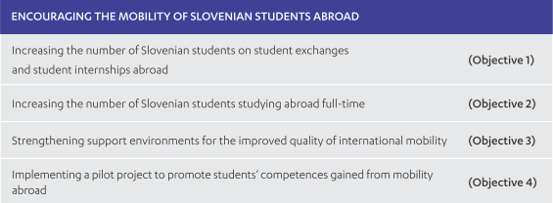
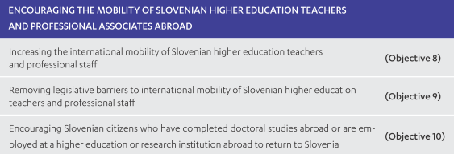
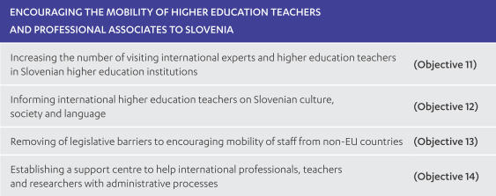
Areas and Objectives
1. Mobility as a key component of the Slovenian higher education community, open to the international environment:
2. Quality international scientific research and development cooperation:

Slide 5
Areas and Objectives
3. Promoting the development of intercultural competences:
4. Targeting priority regions and countries:
5. Promotion, support and monitoring of the strategy:

Slide 6
Student mobility
As is apparent from the Overview of Slovenian Higher Education in the Field of Internationalization, data shows that the mobility of Slovenian and international students and academic staff in Slovenia is among the lowest in the EU.
1. Mobility – Slovenian students „going out“ – mobility (share according to Slovenian students‘ population)
2. Mobility – Foreign students „coming in“ – mobility (share according to Slovenian students‘ population)

Slide 7
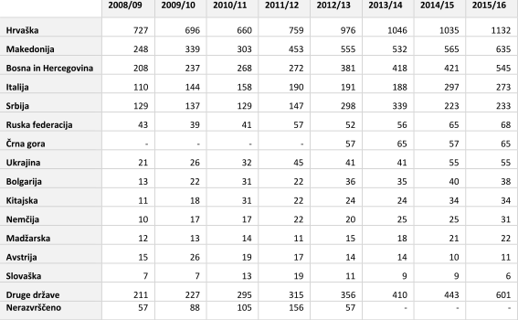
Student mobility
3. Mobility – Slovenian students „going out“ – full study abroad (share according to Slovenian students‘ population)
In 2013 there was 2.370 Slovenians, enroled into study programmes all over the world. Most of the students, are studying in Austria (28 %), Italy (11,2 %), Germany (11, 2 %), USA and Netherlands.
4. Mobility – Foreign students „coming in“ – full study abroad (share according to Slovenian students‘ population)
Last data shows (on 17. 11. 2017) how the numbers are increasing (full time students:
2016/17 – 5,5 %
2017/18 – 7,5 %

Slide 8
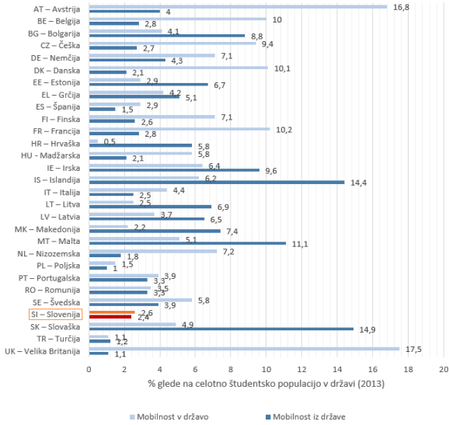
Student mobility
Comparison – share of outgoing and incoming students compared to other countries
Measures, undertaken at national level:
1. OUTGOING MOBILITY:
implementation of programmes Erasmus+ CEEPUS, bilaterals,
additional funding for Erasmus (inclusion of students from disadvantaged backgrounds)
national scholarships
creating a system for monitoring the quality of mobilty,
creating a database of international employers, offering student internship
promoting the impacts of international mobility on the development of competences
Slovenia is placed among last according to number of outgoing and incoming students.

Slide 9
Student mobility
2. INCOMING MOBILITY:
Promoting Erasmus+ programmes, CEPUS, bilateral programmes
Increasing support for mobility and for the process of internationalisation at home (info points, orientation days, Slovene language courses, preparation module for foreign students)
Regulation of the relevant legislation
Regular renewals of study agreements (West Balkan countries)
Changes and amandments to the regulations on tuition fees and accommodation in students‘ dormitories
Offering courses on Slovenian language and culture to international students

Slide 10
Academic mobility
1. Mobility – Slovenian staff – „going out“ (share according to Slovenian academic and professional staff)
2. Mobility – Foreign staff – „coming in “ (share according to Slovenian academic and professional staff)
Collaboration on amendments and additions to legislation
Pilot project – funding of projects, hosted at Slovenian HEIs
Short- and long-term hosting of international experts and HE teachers at slovenian HEIs
Offering courses on slovenian language and culture for foreign HE teachers
Measures undertaken to increase the number of academic and staff mobility at national level:
Promotion of Erasmus+ programmes (staff mobility)
Mobility of Slovenian higher education teachers

Slide 11
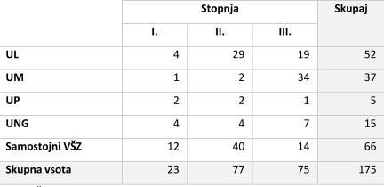
International study programmes
1.Slovenian higher education institutions report that accreditation procedures of international joint study programmes in Slovenia are too complicated and last too long.
2. In 2016 the higher education registry contained 31 international joint study programmes:
3. According to data of the Slovenian ministry of higher education, there are 175 study programmes carried out in English (academic year 2016/17):
23 BA
77 MA
75 PhD
4. Data collected among Slovenian universities show that in 2013 three Slovenian universities carried out 536 courses in a foreign language (366 at UL, 86 at UM and 84 at UP).

Slide 12
International research and events
International scientific research cooperation and the effective transfer of knowledge are fundamental to the successful sharing of research outcomes between higher education institutions and the labour market.
As such, a Strategy for the Internationalisation of Slovenian Science is being drafted for the sector, stemming from the Slovenia’s Research and Innovation Strategy 2011-2020.
Its purpose is to shape and strengthen a successful and internationalised public research sector with a clear mission and vision to create excellent, internationally recognised, competitive research that has a significant impact on economic growth and employment.
Measures, undertaken at national level for better international research and development cooperation:
Removing administrative and technical barriers to ensure international mobility in bothe directions
Enabling an effective network of information on career options for researchers in Slovenia and abroad
Improving quality and quantity of international co-operation
Strengthening the functionality of the national network of national contact point for Horizon 2020
The Strategy for Internationalisation in the Field of Science and Research
Participation in the development of key enabling technologies and future emerging technologies

