Slide 1
Staff and Student Mobility at the University of Maribor
Ana Milovan
ana.milovan@um.si
www.elevate.space

Slide 2
Agenda:
Erasmus+ International Credit Mobility
Student mobility (incoming & outgoing)
Staff mobility (incoming & outgoing)
Q&A

Slide 3
Erasmus+ International Credit Mobility KA107
Credit mobility between Programme and Partner Countries
For students and staff (for learning and teaching)
Action managed by National Agencies located in Europe
PROGRAMME COUNTRIES
PARTNER COUNTRIES
EU, Iceland, Liechtenstein, Norway, Macedonia, Turkey
Whole world without Iran, Iraq, Yemen, Andorra, Monaco, San Marino, the Vatican City State, Bahrain, Kuwait, Oman, Qatar, Saudi Arabia and United Arab Emirates + national restrictions for some countires

Slide 4
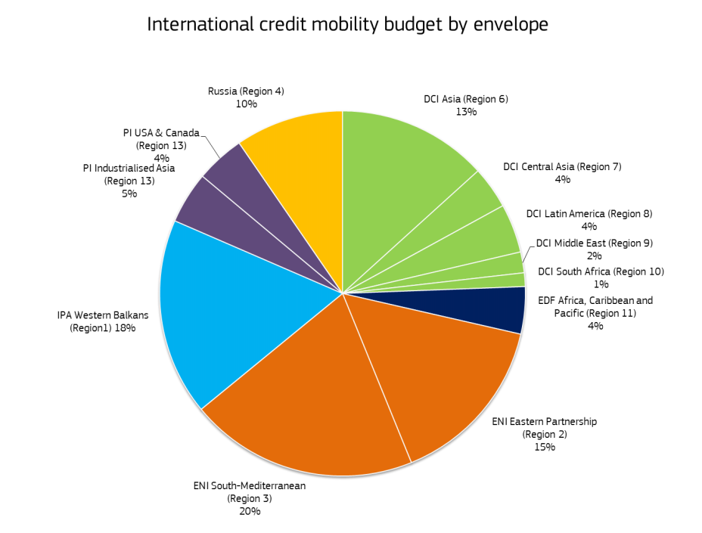

Slide 5
Erasmus+ International Credit Mobility KA107
Application deadline: 1.2.2018
Partner country, partner university, type and direction of mobility
Relevance of the strategy
Quality of the cooperation arrangements (IIA)
Quality of the project design and implementation
Impact and Dissemination

Slide 6
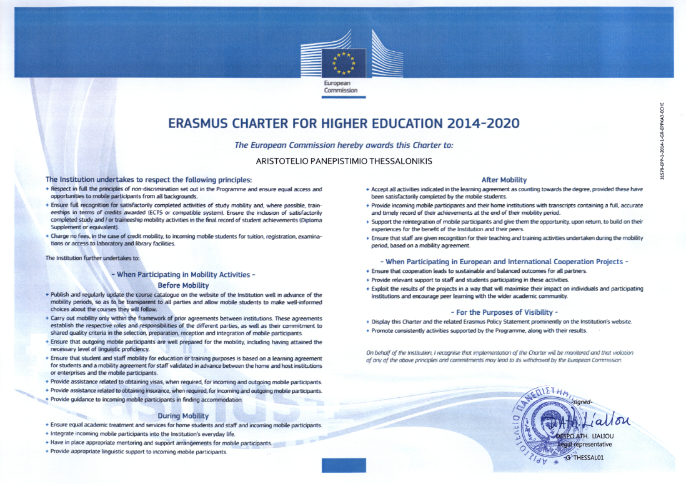
Erasmus Quality Framework
Erasmus Charter for Higher Education – for Partner Countries, the principles of the Charter are embedded in the inter-institutional agreements
Before, during and after mobility

Slide 7
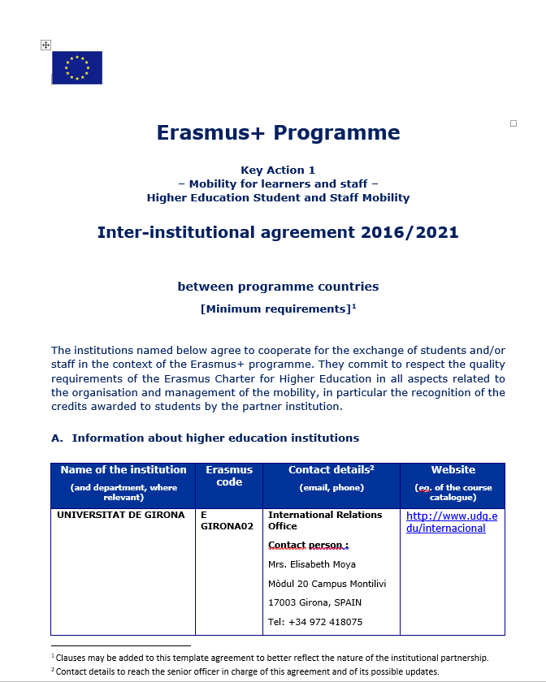
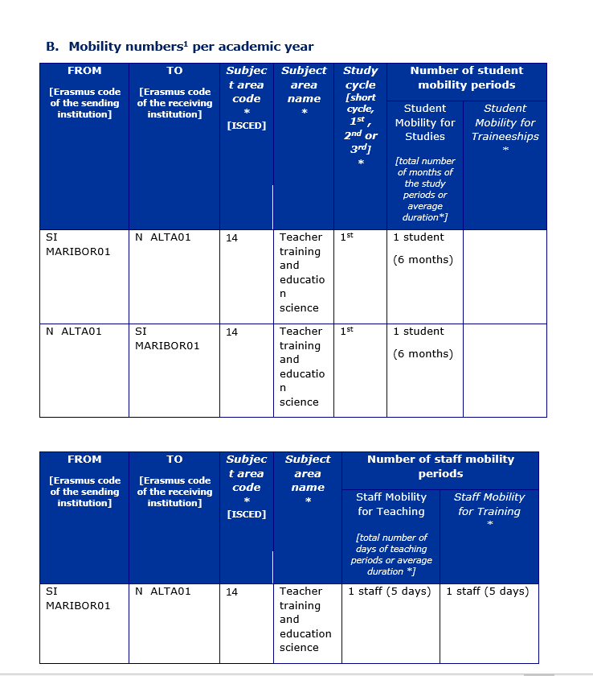
Inter-institutional agreement
Inter-institutional agreements to set mobility flows and preconditions - signed before mobilities start

Slide 8
International Relations Office at the University of Maribor
Erasmus+ faculty coordinators

Slide 9
European
Region
Action
Scheme for the
Mobility of
University
Students

Slide 10
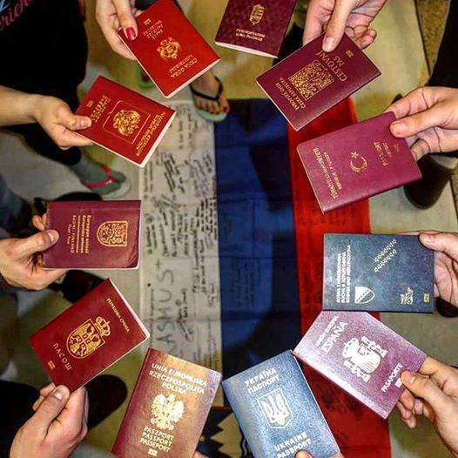
Student mobility
Incoming / outgoing
Without tuition
Erasmus+ status of 12 months
Min. 3 months and max. 12 months
Enrolment at home university, min. 2nd year of studies
Recognition of obligations performed abroad
ECTS (10 ECTS / 3 months, 17 ECTS / 5 months)
Student dorm
Free courses of SLO language
ESN Maribor (buddy, social activities,…)

Slide 11
Student mobility
Scholarship:
800€ / month (26,66€/day) for incoming students
Travel costs:
Special needs students may apply for additional financial support.
Sending state | Hosting state | Amount of grant (EUR/month)
Partner state | Slovenia | 800
Slovenia | Partner state | 650
Distances | Amount of grant (EUR/participant)
Distances from 0 to 99 km | 0
Distances from 100 to 499 km | 180
Distances from 500 to 1999 km | 275
Distances from 2000 to 2999 km | 360
Distances from 3000 to 3999 km | 530
Distances from 4000 to 7999 km | 820
Distances of 8000 km or more | 1100

Slide 12
Student mobility
https://www.um.si/en/international/credit-mobility/Pages/Application-procedure.aspx
Application
1. the Learning Agreement for Studies
2. a transcript of records on all passed exams for all levels of study with average grade
3. a confirmation of English language knowledge on the level of B1
4. a signed declaration on eventual already conducted student mobility
5. a signed declaration on the state of residence, birth and citizenship 6. a motivation letter up to a max. 1 A4 page signed by the applicant
7. Curriculum Vitae (Europass) with mentioned additional activities
8. a valid actual confirmation on enrolment
9. a copy of a valid personal document (passport or ID).
Selection criteria
40% - Academic success of a student in the past academic years 30% - Motivation letter 30% - CV with mentioned additional activities.

Slide 13
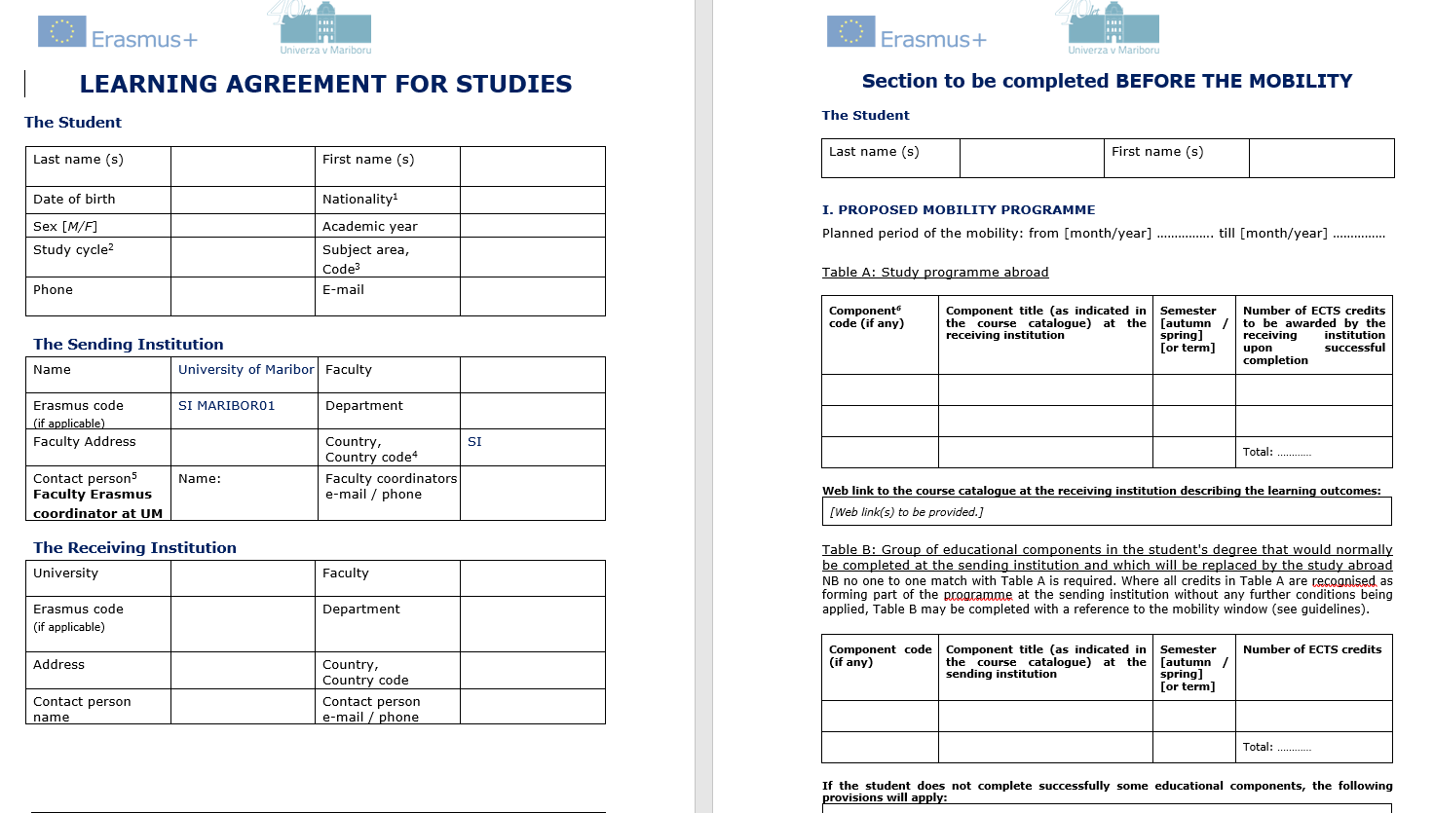
Student mobility

Slide 14
Student mobility
Student
Application documents
Erasmus+ coordinator at the home university
Documents of max. top 5 students
Erasmus+ coordinator at the host university
LA, acceptance lettter

Slide 15
Student mobility
bank account & tax number
grant agreement
50% - 30% - 20%
Final report
Transcript of records, confirmation of mobility
Confirmation of recognition
Mobility Tool questionnaire

Slide 16
Staff mobility
Staff mobility for teaching (min. 8h/week)
Staff mobility for training
- STW
Min 5 days, max 2 months
https://www.um.si/en/international/credit-mobility/Pages/KA107-STTSTA-2017.aspx

Slide 17
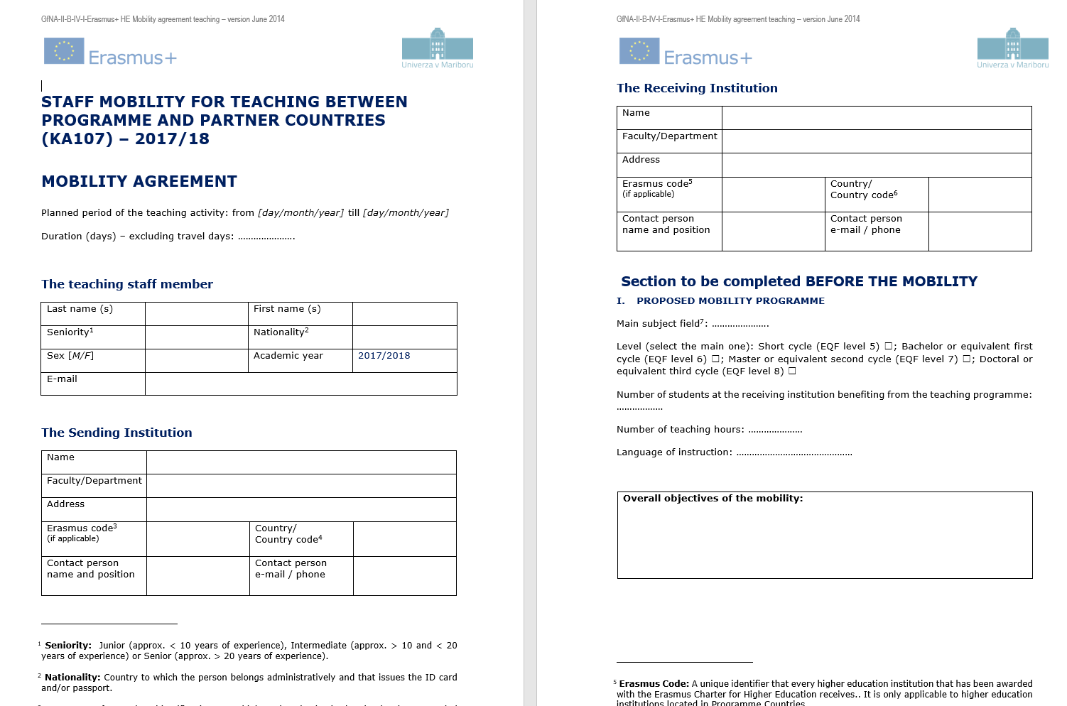
Staff
Application documents
Erasmus+ coordinator at the home university
Application documents
Erasmus+ coordinator at the host university
Mobility Agreement, confirmation
Staff mobility
Application
Application Form
Mobility Agreement

Slide 18
Staff mobility
Sending state | Hosting state | Amount of grant (EUR/day)
Partner state | Slovenia | 100
Slovenia | Partner state | 160
Distances | Amount of grant (EUR/participant)
Distances from 0 to 99 km | 0
Distances from 100 to 499 km | 180
Distances from 500 to 1999 km | 275
Distances from 2000 to 2999 km | 360
Distances from 3000 to 3999 km | 530
Distances from 4000 to 7999 km | 820
Distances of 8000 km or more | 1100
Per diem, all costs of mobility
Mobility Tool questionnaire
Letter of confirmation
Short description of the acquired knowledge and experience

Slide 19
Q&A

Slide 20
THANK YOU!

