Slide 1
Internationalisation of higher education in the UK
Dorin Festeu
Buckinghamshire New University
www.elevate.space

Slide 2
The Context:
Massification of HE - participation rate (17-30 olds in HE): 12%
in 1980s to 48% in 2014/15
Change in the nature and the source of funding: block grant funding to graduate contribution system (Greenaway and Haynes, 2003) - tuition fees & education contracts £9.0 billion in 2010/11 to £15.6 billion in 2015/16 (HESA, 2013; 2016)
Competition within HE and reducing barriers to entry
Post-2010: immigration policies & student mobility (non-EU)

Slide 3
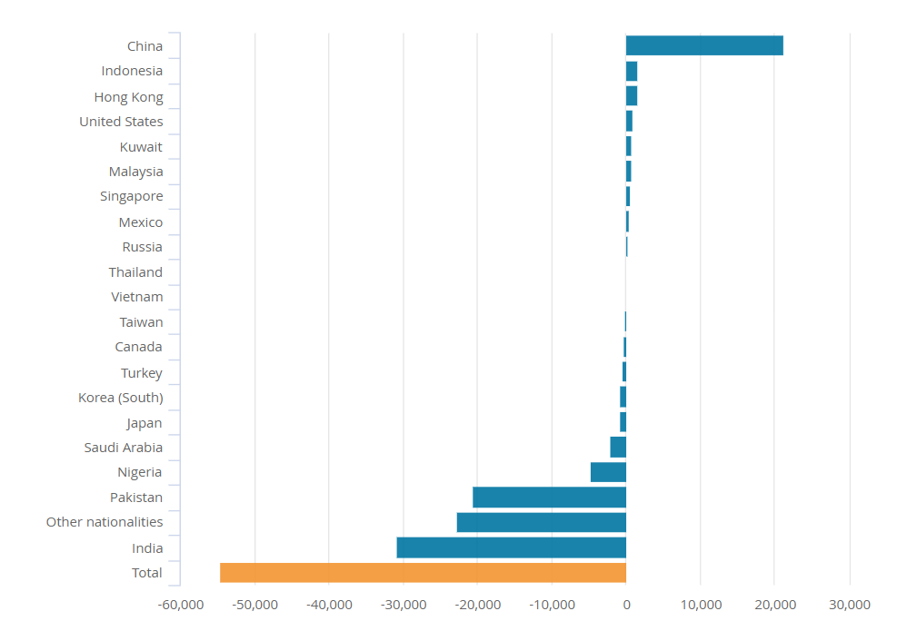
Change in the number of sponsored student visas (Tier 4) 2010 and 2016, UK, www.ons.gov.uk

Slide 4
Why internationalisation?
UK HE have realised that heir course portfolio and awards have commercial value and have taken a decision to realise some of this value by marketing their courses through collaborative provision
(Hodson and Thomas, 2011, p.102; De Vita and Case, 2013).

Slide 5
Why internationalisation? Economic reasons
International activities that focus on ‘increasing
the number of international students enrolled on courses’.
This view of internationalisation has acquired economic meaning within contemporary HEIs.

Slide 6
Why internationalisation? Economic reasons
Various arrangements for delivering learning opportunities with others (Chapter B10: QAA).
HEIs (HEFCE funded) & ‘other’ providers
Various forms i.e. franchising, joint deliveries and validation etc
Involve crossing of organisational and/or national boundaries (Beerkens, 2017) uses the terms international and inter- organisational arrangements

Slide 7
Example 1
HEI - Plymouth Marjon University
+
ABI – a Private for-profit College in London
MA Leadership and Management
MA Leadership and Management (top-up)
BA Business Management
BA Business Management (top-up)
HEIs (HEFCE funded) & ‘other’ providers
Various forms i.e. franchising, joint deliveries and validation etc
Involve crossing of organisational and/or national boundaries (Beerkens, 2017) uses the terms international and inter- organisational arrangements

Slide 8
Trans national education (TNE)
Students based in country Y studying for a degree from
a university in country Z (i.e. UK)
A total of 665,995 students were involved in TNE
provision in 2014/15 (Universities UK, 2016)
With / without local support
1+2 arrangements, 2+1 arrangements, establishing feeder- institutions (for example, pre-masters)

Slide 9
Trans national education (TNE)
Northumbria University Newcastle & Business
Management School (Sri Lanka)
BA (Hons) Business and Management,
BSc (Hons) Human Resource Management and Leadership
BA (Hons) Leadership and Management

Slide 10
UK HE TNE by Region – percentage of TNE Programmes delivered in the regions (2016)

Slide 11
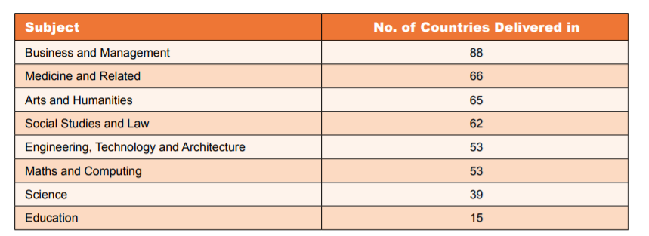
Subject by Number of Countries Delivered (Universities UK, 2016)

Slide 12
Collaborative HE: competing rationales
Widening participation & student numbers
PLC: extension strategies
Geographic reach (access to markets)
Recognition
Towards TDAP (in the UK)
Access to students
Income

Slide 13
Collaborative HE: competing rationales
Widening participation & student numbers
PLC: extension strategies
Geographic reach (access to markets)
Recognition
Towards TDAP (in the UK)
Access to students
Income

Slide 14
Expectations & Academic tensions (role/identity)
understanding - students / market(s)
Lack of clarity:
purpose
Tensions /
dichotomies
Competing priorities
Lack of clarity – partners’ responsibilities
Structural / Systems - i.e. nimbleness / decision making

