Slide 1

MRU INTERNATIONAL: Joint & Double degrees and International Office development
Audra Dargytė Burokienė/ Loreta Paukštytė
www.elevate.space

Slide 2


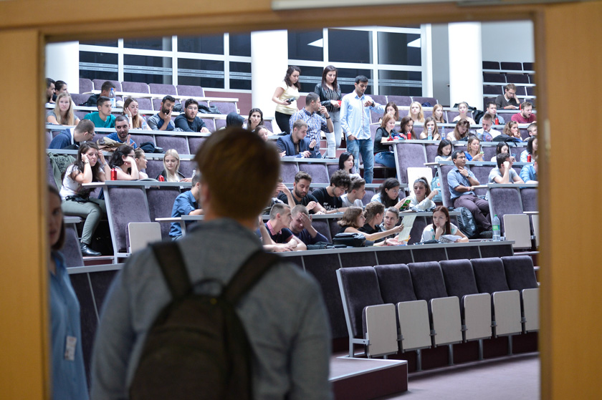
Mykolas Romeris University
Located in: Vilnius, Lithuania
Year of foundation: 1990
Type of Institution: public
Number of students: ~8000 of them >500 international from 58 countries
Number of full-time staff (2017): 310+ 224 adminstrative staff
Faculties: 8 academic units (3 campuses in 2 cities)
Focus areas: SOCIAL SCIENCES - Law, Economics, Finances, Public Governance, Political Science, Business and Management, Psychology, Social Work, ICT, Communication, etc.
Commitment to Internationalization is integrated in Institutional Strategy (from 2010 - latest review adopted for 2016-2020 period)

Slide 3
Mykolas Romeris University
Contexts for International studies
Our of 90 study programmes run at MRU in 2017 (30 – I, 59 – II, 1-non-degree) :
  9 joint study programmes
  6 double degree or validated programmes
  6 single award programmes taught in English
Doctoral studies in 6 fields: Law, Management, Economics, Psychology, Education Science, Philology
  All possible for International students

Slide 4
Mykolas Romeris University
International studies
Joint study programmes (2017)
I- Informatics and Digital Contents (Joint study programme with KR) II- European and International Business Law (joint study programme with FR) II- Legal Regulation of Public Administration and Human Rights (JSP with UA) II- Private Law (JSP with UA) II- Intellectual Property Law (JSP with UA) II- European joint master’s in Strategic Border Management (joint study programme with NL, LV, ES) II- Comparative Social Policy and Welfare (joint study programme with FI, AT) II- Social Work with Children and Youth (joint study programme with LV) II- Work and Organizational Psychology (joint study programme with EE,2y)

Slide 5
Mykolas Romeris University
International studies
Double degree or validated study programmes (2017)
I- Financial Economics (DD with MDX 3,4 y) I- Business Informatics (DD with MDX 3,4 y) II- EU Law and Governance (DD with FR) II- Electronic Business Management (DD with MDX 2 y) II- Creative Technologies and Communication (DD with MDX 2 y) II- Financial Markets (DD with MDX 2 y)

Slide 6
Mykolas Romeris University
International studies
Single award study programmes taught in EN(2017)
I- Tourism Management and Heritage I- English for Specific Purposes and the Second Foreign Language I- Psychology I- Social Work and Legal Fundamentals II- Business Administration Master of Business Administration - MBA) II- International Law (Master of Law)

Slide 7
Mykolas Romeris University
International studies
International study programmes (active in 2017/18): Undergraduate (Bachelor)
Informatics and Digital Contents (Joint study programme with KR) Financial Economics (DD with MDX 3,4 y) Tourism Management and Heritage English for Specific Purposes and the Second Foreign Language Psychology Social Work and Legal Fundamentals Also there is a group taking minor studies of English (1 year) before the BA programmes to improve English language proficiency from A2

Slide 8
Mykolas Romeris University
International studies
International study programmes (active in 2017/18): Graduate (Master) – single awards, joint or double degree
Financial Markets (Master of Economics) Electronic Business Management (Master of Business and Management) Business Administration Master of Business Administration - MBA) International Law (Master of Law) European and International Business Law (joint study programme with FR) Legal Regulation of Public Administration and Human Rights (JSP with UA) Private Law (JSP with UA) Intellectual Property Law (JSP with UA) European joint master’s in Strategic Border Management (joint study programme with NL, LV, ES) Comparative Social Policy and Welfare (joint study programme with FI, AT) Social Work with Children and Youth (joint study programme with LV) Work and Organizational Psychology (joint study programme with EE,2y)

Slide 9
Mykolas Romeris University
WHY JSP or DD programmes???
International studies
For HEI
For students
New stage/level and more demanding cooperation (student mobility – student/staff exchange-JSP)
Integrated approach to Curricula - modules complement and lead to homogenous programme with full recognition at all JSP universities
University or National Policy
Stronger European degrees/ higher level of visibility
Studies in several universities at the same time /Integrated mobility with clear study plan
1 (higher) effort for more beneficial outcome (double or joint degree)
Hopes for better (international) career

Slide 10
Requirements to JSP (in LT)
Jointness in development of JSP with Duration (90 -120 ECTS)
Compulsory academic mobility
Accredited, validated (legalized) in all countries
At least 25% of credits earned at other than home institution (by physical academic mobility)
Commission for assessment of student’s final work include all partner HEIs conferring a joint degree.
Signed agreement for implementation of the JSP by heads of HEIs, which includes chapters on:
  Title (in national languages), scope and length of studies, language of instruction;
  Principles of QA (internal and external);
  Conditions and procedure of students admission;
  Procedure of providing study funding and assistance for students to adjust in difference social, cultural environment;
  Commitments to intellectual property protection;
  Procedure of conferring a joint qualification degree and issuing a qualification document(s);
  Liability of parties for improper execution of the Agreement; conditions for termination;
  Other conditions.

Slide 11
Mykolas Romeris University
Examples of JSP good practice
International studies
Comparative Social Policy and Welfare
Social Work with Children and Youth
European and International Business Law
Strategic Border Management

Slide 12
Students meet for IP and Further virtually
MRU (admission)
UTA (admission)
JKU (admission)
Semester 1:
2 weeks IP in Vilnius and return to home University for virtual contact work
Semester 2 :
2 weeks IP in Tampere and return to home University for virtual contact work
Semester 3 :
2 weeks IP in Linz and return to home University for virtual contact work
Semester 4: Thesis work (All U. participate in defence)
Semester 4: Thesis work
(All U. participate in defence)
Semester 4: Thesis work
(All U. participate in defence)
Recognition
Joint degree (or National degree + joint certificate)
http://cosopo.ma.mruni.eu

Slide 13
Students moving together
I year
1 semester at MRU
2 semester at MRU
II year
3 semester at SMBU
4 semester - Internship and master thesis
Joint supervision and defence. 2 Diplomas
http://eibl.ma.mruni.eu

Slide 14
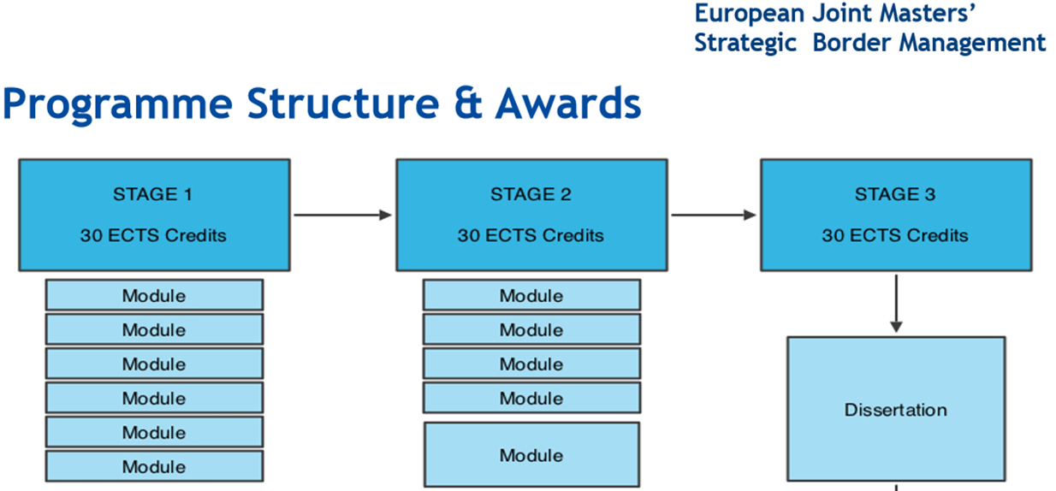
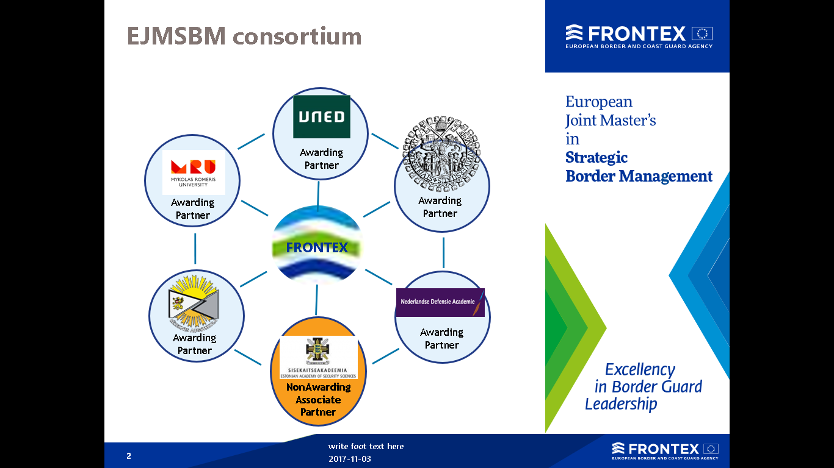
Students moving around for modules
96 teaching staff and 5 external examiners From 14 countries, 20 Universities, 8 BG academies and 5 International organizations
http://sbm.ma.mruni.eu

Slide 15
CHALLENGES
How to finance the development (how long does it take? How is it registered/accredited? What is a duration of accreditation in each country?)
How to finance the implementation?
How to enrol students (from day 1 in all universities or from the start of mobility)?
How many students?
How to finance student mobility?
How to not to give up?...

Slide 16
Suggestions
Start from the Aims of the Programme (Learning outcomes) – will value be added from the jointness (must be clearly defined for students)
complementary and homogenous curricula – maybe more optional/alternative courses (which have similar learning outcomes)
Mobility scheme should be developed BEFORE the start of the programme and clear for students
Trust in partners, have Institutional support
Plan the financial support possibilities for mobility!!!

Slide 17
Mykolas Romeris University
Examples of DD good practice
International studies
European Union Law and Management
Financial Markets
International Law

Slide 18
Mobility of Professors only
EU Law and Governance (90 ECTS)
Studies take place at MRU
Partners: MRU and Bordeaux University (FR)
1 & 2 semester
Taught courses and internship
Teaching by professors from MRU and BU
3 semester
Master thesis
Possibility for International Mobility (Erasmus+ studies of traineeship)
Joint supervision and defence. 2 Diplomas
http://eulg.ma.mruni.eu

Slide 19
Recognition of credits from PU
Financial Markets (90 ECTS)
Studies begin at PU for 1 or 2 semesters and must include courses, agreed in advance
Partners: AZ, UA
2 semester
Taught courses at MRU
Recognition of previous credits (30) takes place at MRU thus
3 semester
Master thesis
Possibility for International Mobility (Erasmus+ studies of traineeship)
MRU supervision and defence. MRU Diploma (and PU diploma)
http://fm.ma.mruni.eu

Slide 20
Recognition of credits from PU
International Law (120 ECTS)
Studies begin at PU for 1 or 2 semesters and must include courses taught in EN, agreed in advance
Partners: UA
2 semester
Taught courses at MRU
Recognition of previous credits (30 ECTS) takes place at MRU
3 semester
Obligatory Mobility to another set EU University Faculty of Law (Erasmus+ studies)
4 semester
Master thesis and traineeship at International Organization
Possibility to apply for Erasmus+ traineeship mobility
MRU supervision and defence. MRU Diploma (and non-EU PU diploma)
http://il.ma.mruni.eu

Slide 21


Joint Doctoral Programmes
LAST-JD (“Joint International Doctoral Degree in Law, Science and Technology”)
http://www.last-jd.eu
RUCHIN (“Contemporary Russian and Chinese Economic Law in a Global Economy” )

Slide 22
Strategic level
Issues/challenges to discuss
Administrative/academic level
Expected results
Student’s profile
- Ensuring sufficient number of applicants
- Limited Interest in long-term studies (work, family issues)
Admission requirements & selection
- Mapping legal requirements
- Admission procedure reflected in Study guide
Scope of the programme
Degree awarded
- Joint/double PhD degree
- Field of PhD studies
- Admission requirements related to prior education
Requirements for completion of the programme
- Mapping legal requirements
- Recognition of study results
- Diploma supplements (if possible)
Type of studies
- Taught PhD studies (extra costs for teaching & administration, equalizing the capacity of students)
- Research PhD studies (less interaction with the students, differences in capacity to do research)
Methodology and curriculum development
- Study Programme Structure & components
- Study assessment criteria
Partnership & governance
- Right to conduct PhD studies
- Academic capacity issues (related to language policy)
- Status of full and associated partners
Partnership Agreements
- Partnership agreement (including rules on governance)
- Placement agreements
- Guidelines for tutoring professors
Mobility strategy
- Obligatory mobility periods (if any)
- Type of mobility (research or (&) practice placements)
- Limited to partners institutions, if no issues in recognition
Mobility scheme
- Student and staff mobility guide (mobility rules, studying abroad assistance system, etc.)
Funding
- Internal/External funding
- “Capacity” to receive external funding
Funding rules
- Funding guide

Slide 23
Strategic components
Strategic decisions
Operating decisions/structures
Student’s profile
Having specific interest in the field
- No special profile, common selection criteria (quality of the university career; quality of motivation letter; academic potential, letters of recommendation)
RUCHIN (“Contemporary Russian and Chinese Economic Law in a Global Economy” )
- Double PhD degree
- Studies resulting in PhD in law or social sciences (law)
- Bridge studies for non having a Master’s degree in law
Degree awarded
Double
Type of studies
Taught PhD
- Taught PhD studies (International economic law, Russian economic law/Chinese economic law)
- Bridge studies up to 30 ECTS, Field (core & specialized) subjects 90 ECTS, research & dissertation component 90 ECTS
- University of Lapland (coordinator, Finland), Vrije Universiteit Brussel (Belgium),
University of Maribor (Slovenia) and Mykolas Romeris University (Lithuania), associated partners: Ural State Academy of Law (Russia) and EU School of Law at the China University of Political Science and Law.
- Network established/no framework decision/implementation based on bilateral agreements depending on mobility track
- Recognition of credits within the network
Partnership & governance
Full/Associated partners
Mobility strategy
Partially flexible
- 2 recommended training/research periods in 2 European countries and 1 recommended training/research period in the third country partner university
- Mobility scheme is the choice of a student approved by the supervisors
Funding
Internal & External
- Internal/External funding
- Exclusively state funded – VUB & ULAP

Slide 24
LAST-JD (“Joint International Doctoral Degree in Law, Science and Technology” )
Strategic components
Strategic decisions
Operating decisions/structures
Student’s profile
Having specific interest in the field
- No special profile, common selection criteria (quality of master degree and pertinence with the LAST-JD project; research project; university career; quality of motivation letter; letters of recommendation; proficiency in English)
Degree awarded
Joint/Double
- Joint PhD degree (except Luxemburg – double degree (cotutelle agreements))
- Studies resulting in PhD Degree in Law, Science and Technology
- Taught PhD studies (programme is structured in three alternative tracks: Bioethics and Biolaw, ICT Law and Legal Informatics)
- Field (core & specialized) subjects 1200 hours, research & dissertation 3300 hours; total 4500 hours (3 years)
Type of studies
Taught PhD
- 6 Full Partners, 11 Associate partners and 9 Industrial partners. Full Partners: University of Bologna (coordinator), University of Turin, Autonomous University of Barcelona, Mykolas Romeris University, University of Luxembourg, University of Tilburg; associated partners: academic bodies (universities) and research centers; industrial partners: IBM, Nexen etc.
- Based on the agreement between full partners (except Luxemburg)
Partnership & governance
Full/Associated/
Industrial partners
Mobility strategy
Partially flexible
- I year: University of Bologna (I semester), University of Turin (II semester)
- II year: Autonomous University of Barcelona or Mykolas Romeris University (I semester), University of Luxembourg or University of Tilburg or University of Hannover (II semester)
- III year: Any full, associated or industrial partner
- Mobility scheme is the choice of a student approved by the supervisors
Funding
Erasmus/
Internal/External
- Erasmus Mundus
- Internal/External funding (industrial partners etc.)

Slide 25
Mykolas Romeris University
International Office
International Services
Setting in the organizational structure
Goals and activitie
Internal divisions
Human resources

Slide 26
Set tangible targets related to internationalization
Indicator | Status in 2015/2016 | Target for 2019/2020
% of all MRU students outgoing for international mobility under exchange programmes annually | 2,2% | 5%
% of international degree-seeking students in BA and MA cycle | 2,6% | 5%
% of outgoing staff (for teaching or training) | 11,6% | 15%
Ratio of incoming and outgoing staff | 2:3 | 1:1
% of international degree-seeking students in PhD cycle | 1,2% | 5%
International projects (new annually) | 24 | 31

Slide 27
IO in the structure of the MRU
Vice-Rector for Education and Research
Research and Innovations Support Centre:
- Social Innovations doctoral school
Knowledge and technology transfer
Projects office
MRU Library
International Office:
- International Mobility and Students
- International Partnerships
+
Asian centre
King Sejong Institute Vilnius
Francophone countries study centre
Academic Affairs Centre:
Study:
- Study process administration
- Study programmes and QA
- Career centre
- Digital studies

Slide 28
International Office aims to:
Assist in development of University internationalization and competitiveness (analytical, advisory support)
Coordinate international cooperation and partnerships with Universities, international organizations, networks, diplomatic missions, lithuanian communities abroad
Coordinate participation in exchange programmes, scholarship schemes, marketing activities abroad
Organize international student recruitment, admission, provide non-academic support during entire stay at MRU (including housing, visa, TRP)
Provide information to MRU students and staff about international mobility possibilities, available mobility funding and provides assistance needed.
Administer activities of Asian and Francophone countries study centres

Slide 29
INTERNATIONAL OFFICE
International Mobility and Students Division
International Partnership Division
Asian Centre
KSI Vilnius
Exchange students:
Outgoing and Incoming
New and ongoing partnerships, memberships
International marketing, recruitment, admission
Staff mobility: Outgoing and Incoming
Franco- phone studies centre
International students support
Protocol issues, delegations, business communication, databases
Exchange programmes partners

Slide 30
Staff Resources
1 for analytical and advisory support to rector’s office, IO coordination, E+ applications, financial planning, reporting, new developments
1 for partnerships, delegations, planning (+office mngm.)
1 for staff mobility (+ Fr)
0,5 for As (+ KSI Vilnius)
0,5 for rector’s office intl. correspondence, agreements, databases
1 for outgoing students
1 for incoming students
1 for international admission
1 for intl. student support
0,5 for intl. Marketing
0,5 for academic recognition of foreign qualifications

Slide 31
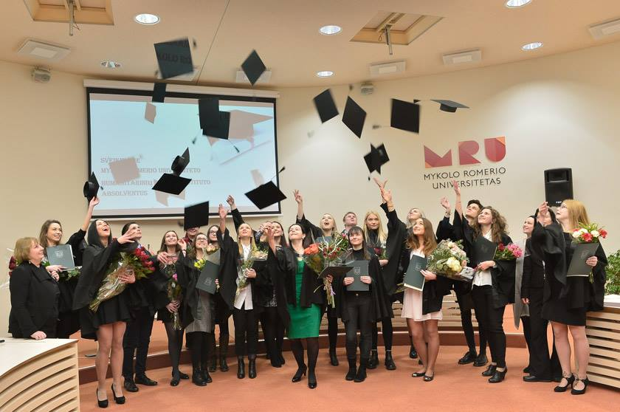
Mykolas Romeris University
International Office
Ateities st. 20, Vilnius, LT-08303, Lithuania
e-mails: erasmus@mruni.eu
www.mruni.eu http://erasmus.mruni.eu
FB: MRU Erasmus+

