Slide 1
P4, Alecu Russo Balti State University (USARB)
Session II: ELEVATE ELEVATE project`s Dissemination, Exploitation. Period: 15/10/2017 - 14/10/2018
Vice-rector for research and international relations,
Institutional coordinator of the ELEVATE project
Project No. 573921-EPP-1-2016-1-MD-EPPKA2-CBHE-SP
Project title: “ELEVATING THE INTERNATIONALISATION OF HIGHEREDUCATION IN MOLDOVA – ELEVATE”
Title of the event: Third consortium meeting (cm3)
Period: 12-13 March 2019
Venue: Academy of Economic Studies of Moldova (61, Banulescu- Bodoni str., Building A, 3rd floor, Senate room, Chisinau, Republic of Moldova
)
Valentina PRITCAN

Slide 2
DISSEMINATION ACTIVITY I
USARB Dissemination
Dissemination activity (e.g. workshop, conference, exhibition, etc.) | TRIANGLE 2018, 4th Edition. International Scientific and Practical Forum "Fostering Knowledge Triangle In Moldova”
Date and place | 26-27 April 2018 Academy of Economic Studies of Moldova (ASEM)
Name and title of the person participated | Valentina PRITCAN, PhD, Associate Professor, institutional project coordinator; Svetlana MELNIC, International Officer, Department of International Relations, USARB.
Attachment: please attach any material used (presentation, leaflet, project description, photos etc.) | http://www.triangle.md/assets/triangle-2018-programme.pdf http://www.old.usarb.md/evenimente/articol/evenimentele-proiectului-elevate-in-cadrul-forumului-triangle-2018/ https://www.facebook.com/universitatea.alecu.russo/posts/1677014322353596

Slide 3
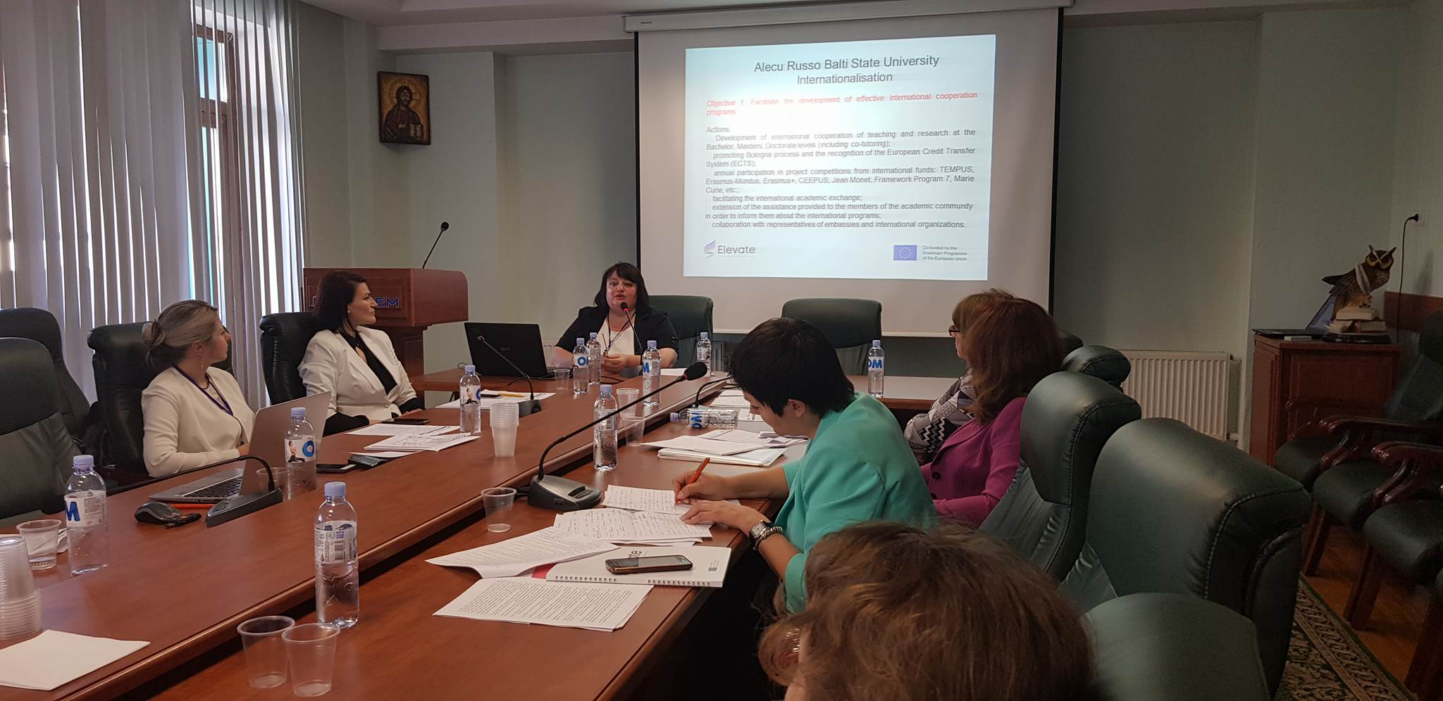
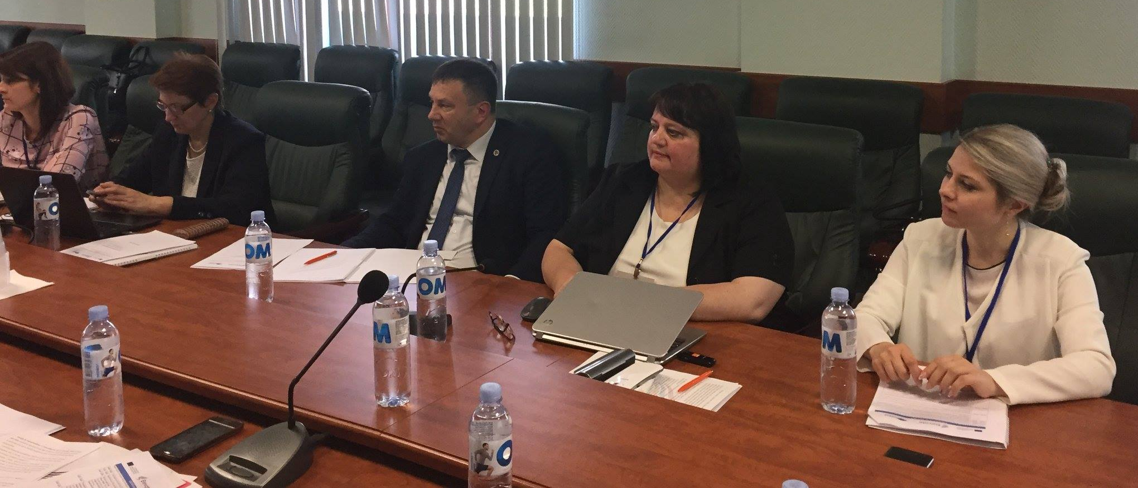
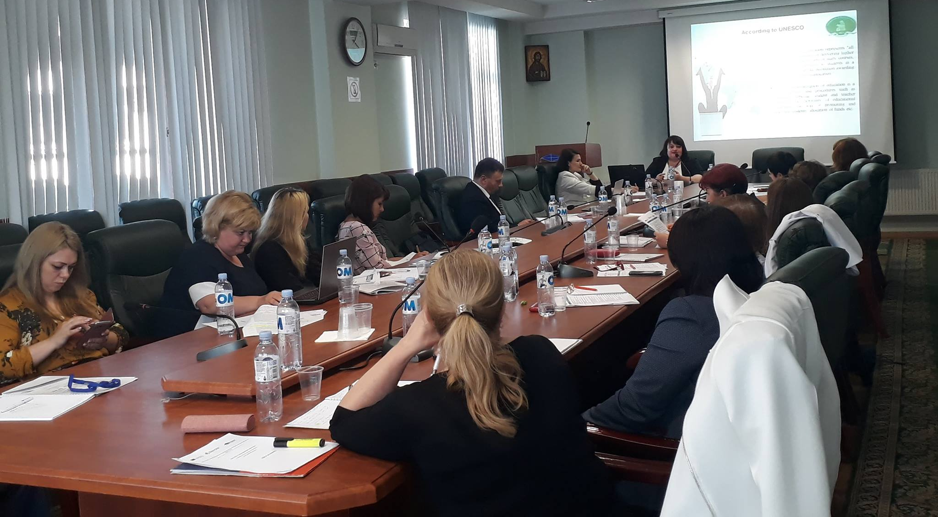
USARB Dissemination

Slide 4
DISSEMINATION ACTIVITY II
USARB Dissemination
Dissemination activity (e.g. workshop, conference, exhibition, etc.) | International Workshop: Double degree and internationalization of the moldovan HEIs. within TRIANGLE 2018- 4th Edition. International Scientific and Practical Forum "Fostering Knowledge Triangle In Moldova”
Date and place | 27 April 2018 TEKWILL, Technical University of Moldova
Name and title of the person participated | Valentina PRITCAN, PhD, Associate Professor, institutional project coordinator; Svetlana MELNIC, International Officer, Department of International Relations, USARB.
Attachment: please attach any material used (presentation, leaflet, project description, photos etc.) | http://www.triangle.md/assets/triangle-2018-programme.pdf http://www.old.usarb.md/evenimente/articol/evenimentele-proiectului-elevate-in-cadrul-forumului-triangle-2018/ https://www.facebook.com/universitatea.alecu.russo/posts/1677014322353596

Slide 5
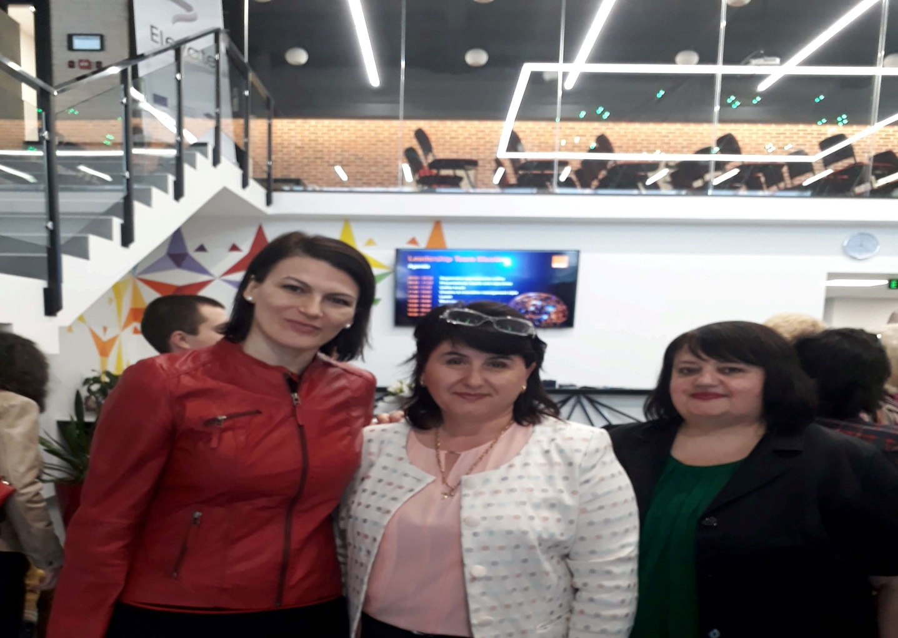
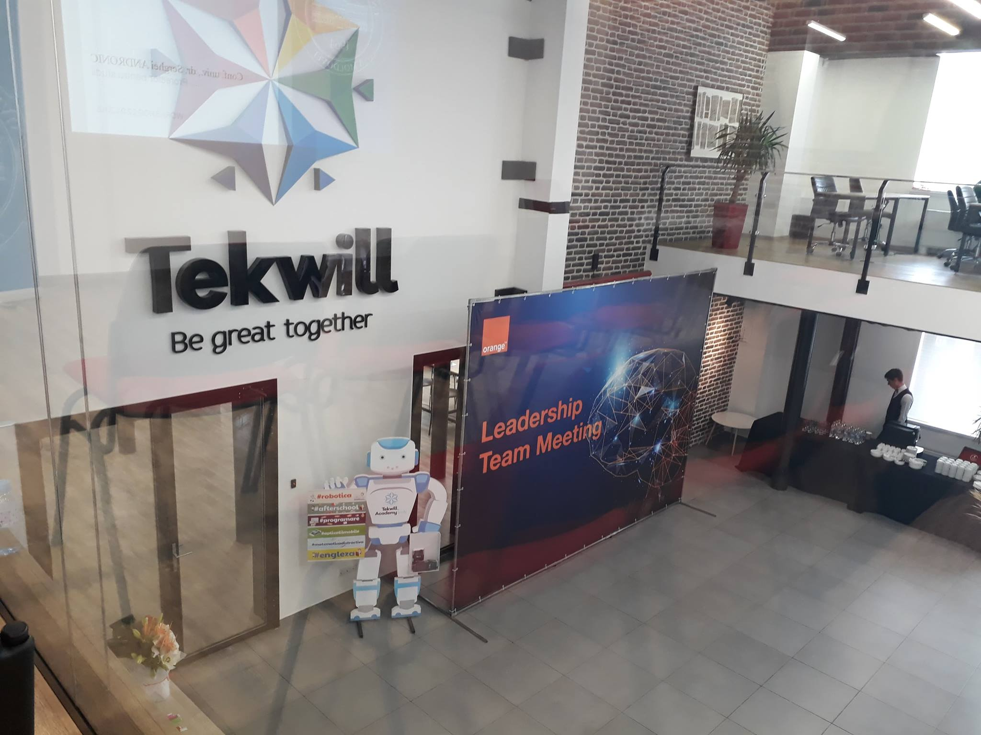
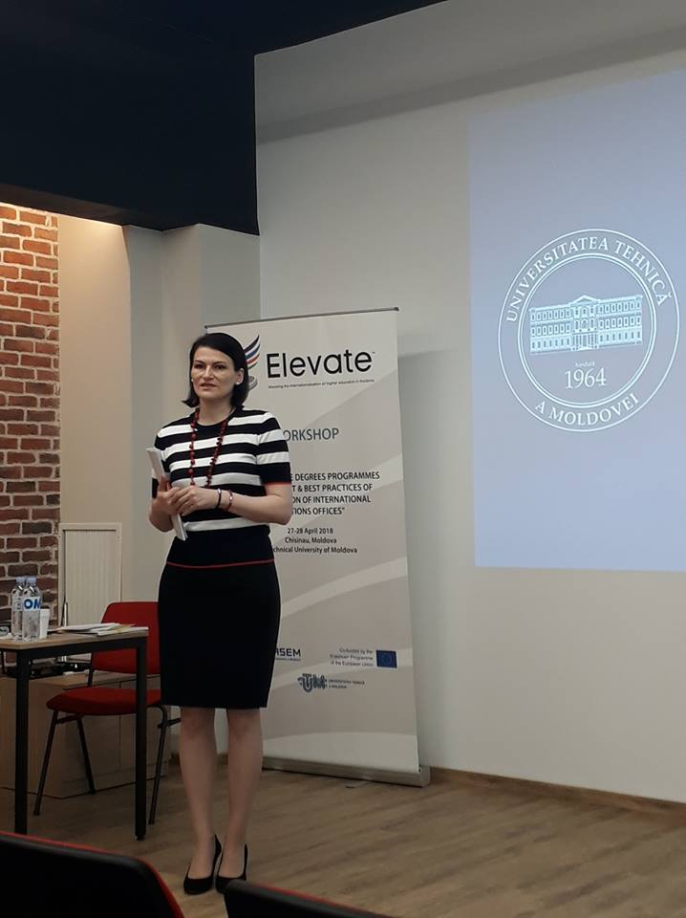
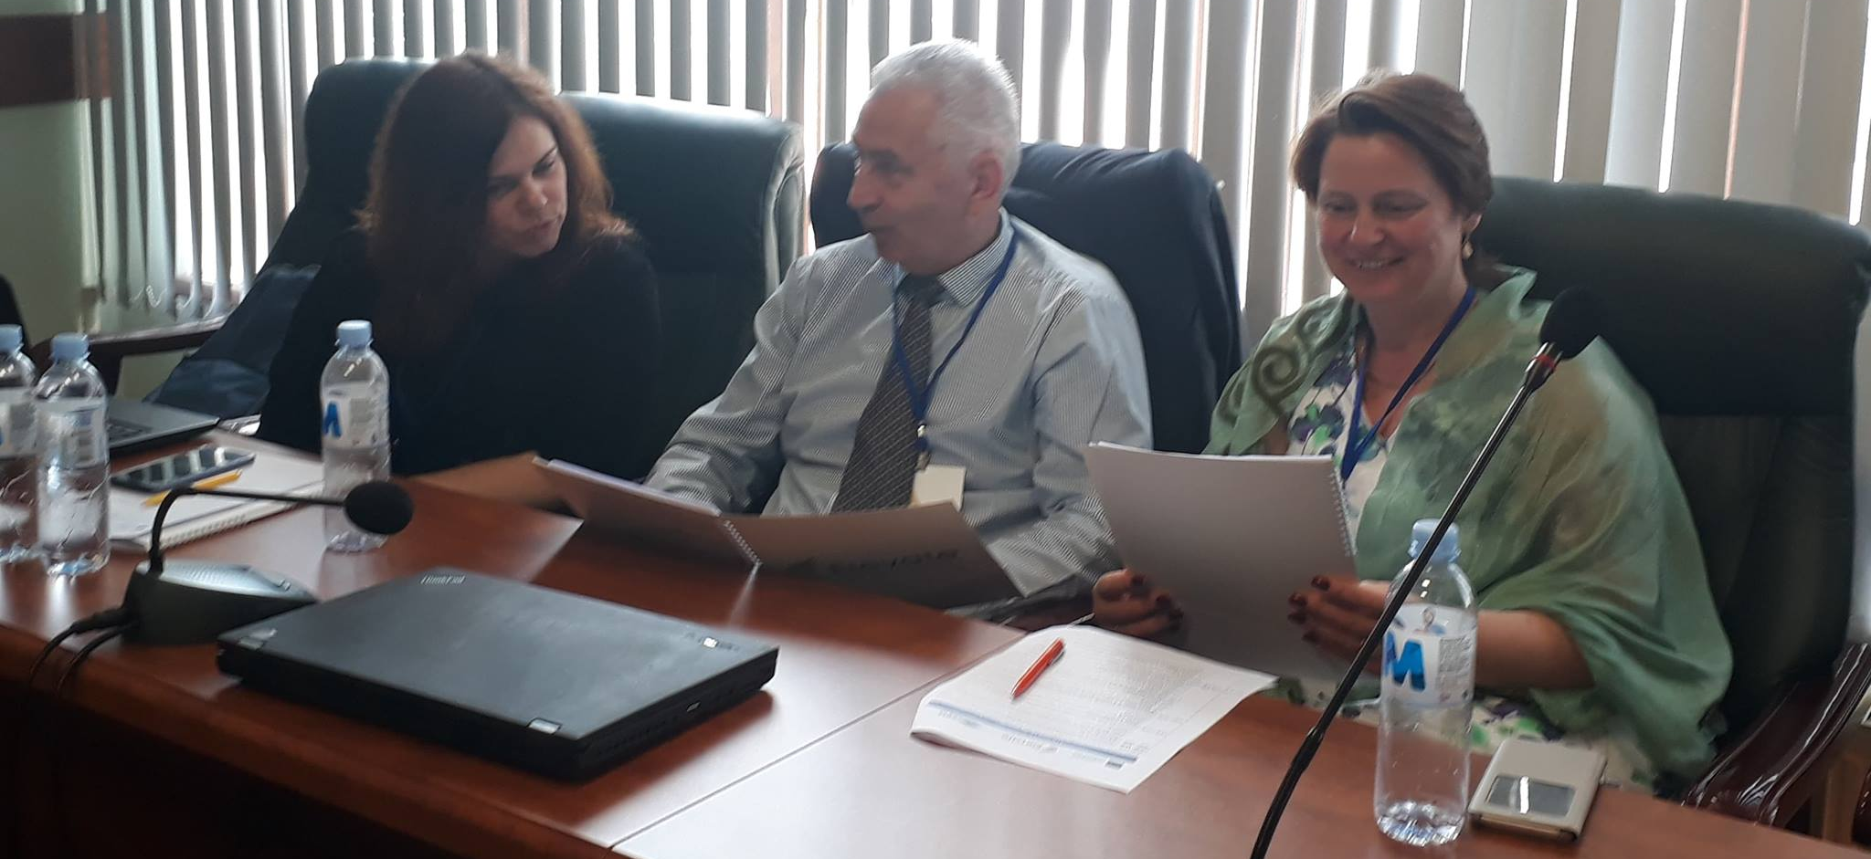
USARB Dissemination

Slide 6
DISSEMINATION ACTIVITY III
USARB Dissemination
Dissemination activity (e.g. workshop, conference, exhibition, etc.) | Presentation of the ELEVATE Project in the Europe Days 2018 at USARB. Information Seminar on Erasmus + projects, KA2, implemented with USARB participation.
Date and place | May 24th, 2018 Alecu Russo Balti State University (USARB)
Name and title of the person participated | Valentina PRITCAN, PhD, Associate Professor, institutional project coordinator.
Attachment: please attach any material used (presentation, leaflet, project description, photos etc.) | USARB web page: http://www.old.usarb.md/evenimente/articol/proiecte-erasmus-cu-implicarea-usarb/ http://www.old.usarb.md/evenimente/articol/activitati-dedicate-zilei-europei/ http://www.old.usarb.md/fileadmin/2018_Avize/Ziua_Europei_2018__1_.pdf USARB Facebook page: https://www.facebook.com/usarb.balti/photos/pcb.2152723488292266/2152723261625622/?type=3&theater

Slide 7
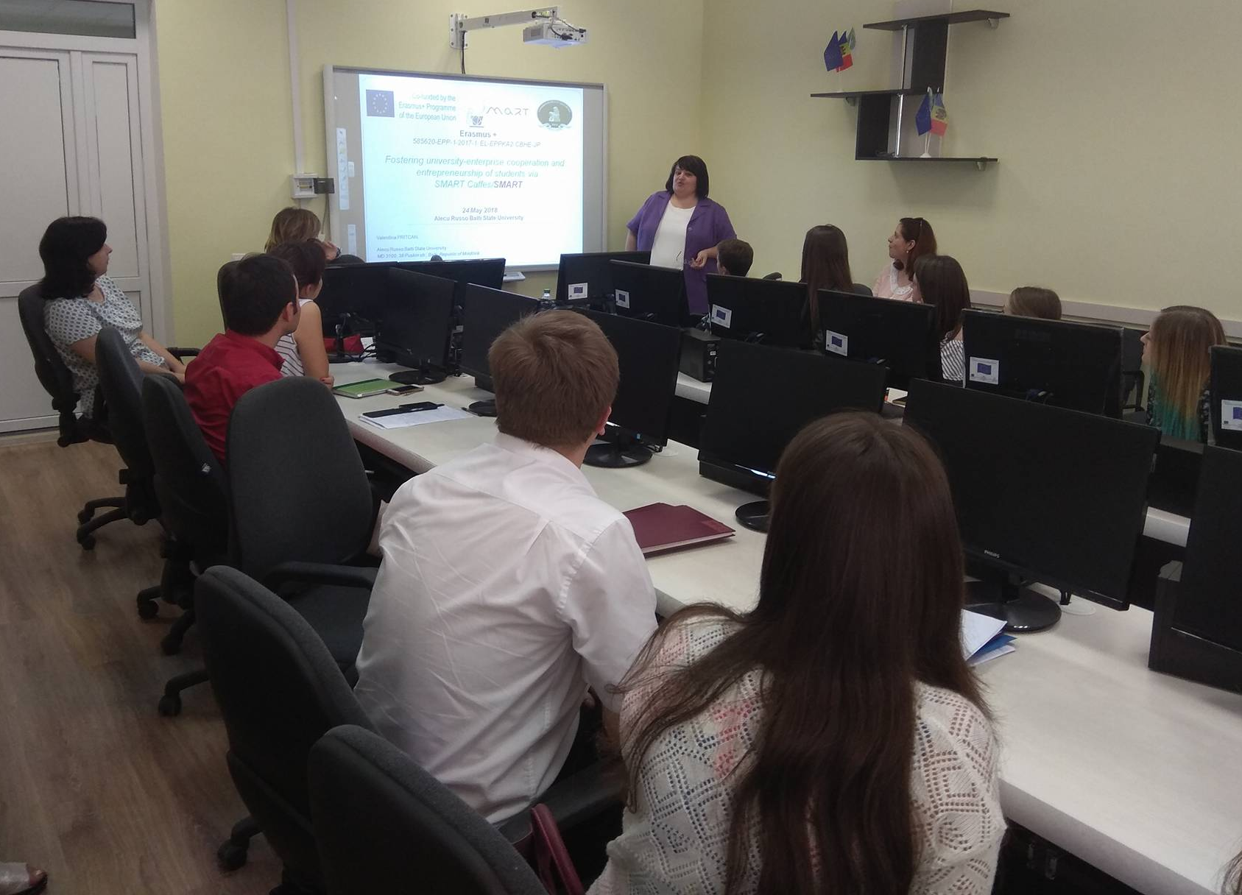
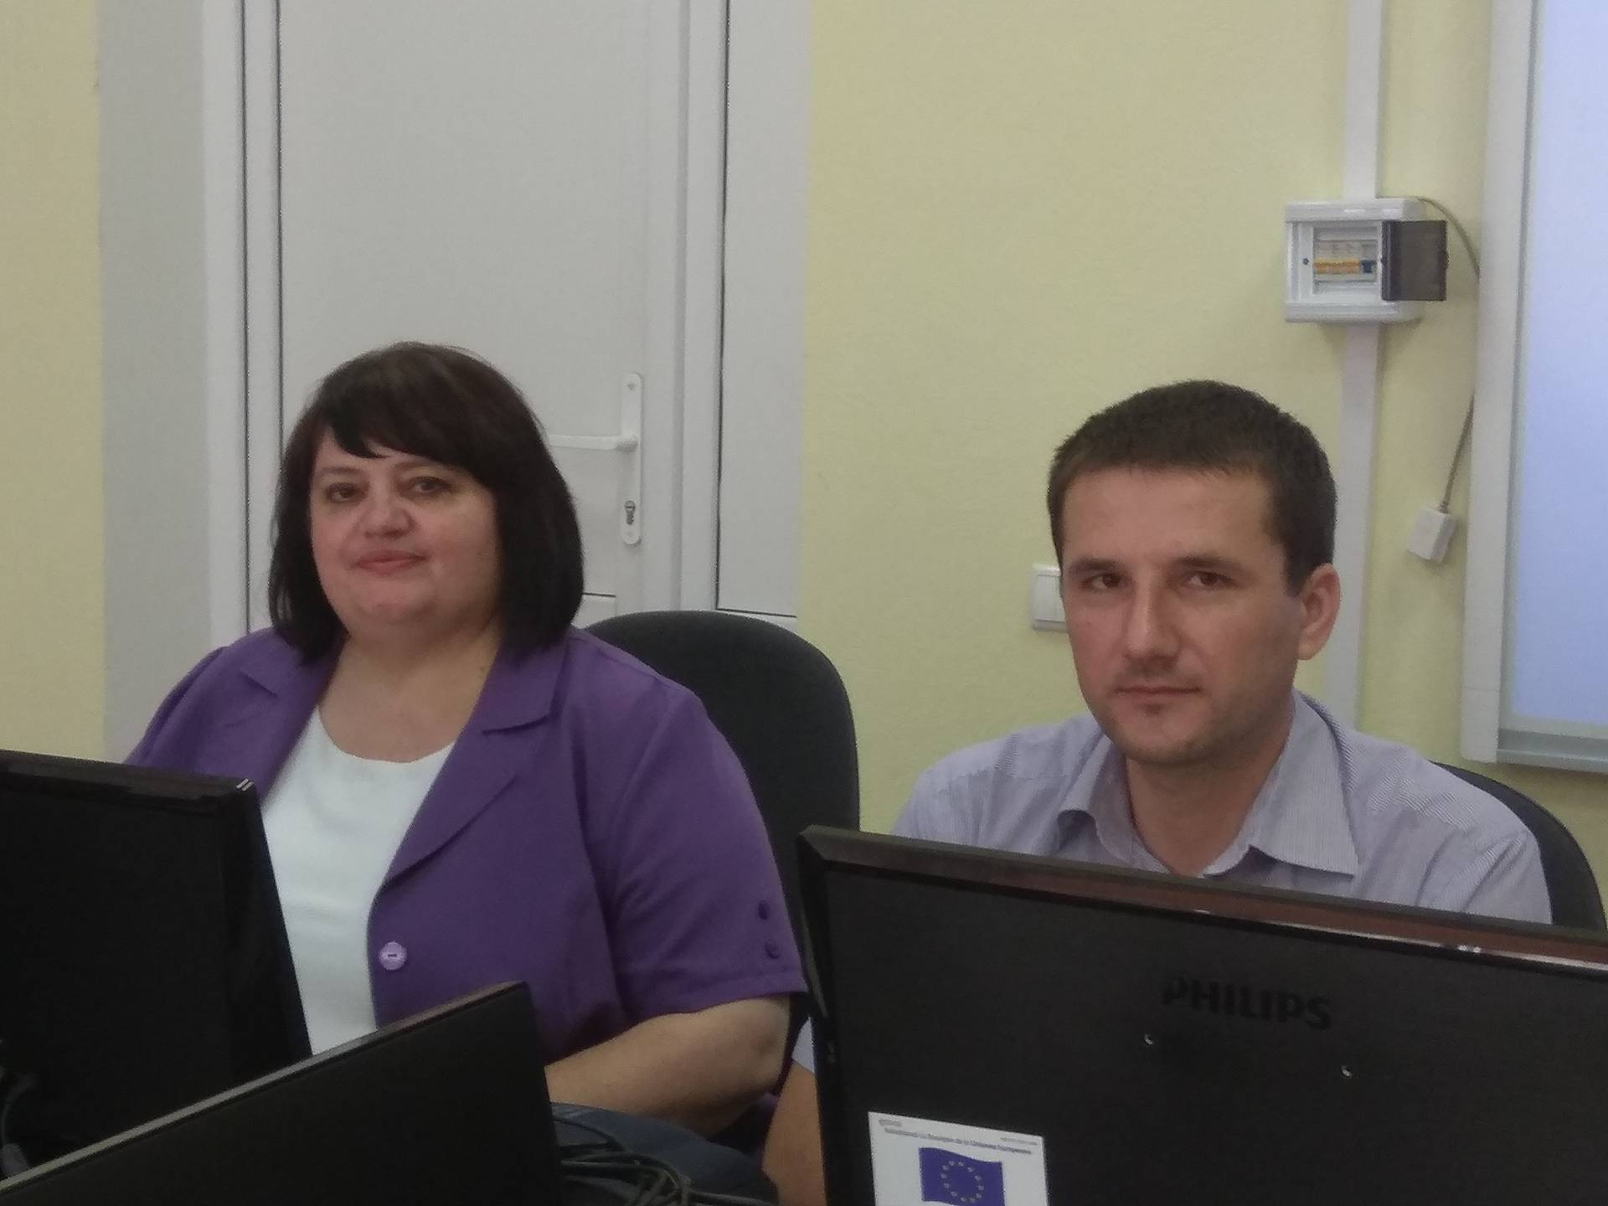
USARB Dissemination

Slide 8
DISSEMINATION ACTIVITY IV
USARB Dissemination
Dissemination activity (e.g. workshop, conference, exhibition, etc.) | Permanent update of the ELEVATE project web page project page on the USARB website.
Date and place | Permanently USARB web page: http://www.usarb.md/elevate/
Name and title of the person participated | Valentina PRITCAN, PhD, Associate Professor, responsible for dissemination of ELEVATE project at institutional level.
Attachment: please attach any material used (presentation, leaflet, project description, photos etc.) | USARB web page: http://www.usarb.md/elevate/ On the USARB web page there were placed following information sheets: about project - http://www.usarb.md/elevate/ ELEVATE project team - http://www.usarb.md/elevate/echipa/ about the ELEVATE activities - http://www.usarb.md/elevate/activitati/ about the expected results - http://www.usarb.md/elevate/despre/ about the project publications/ flyers http://usarb.md/publicatii-elevate/ about the activities and news - http://www.usarb.md/elevate/evenimente-si-noutati/

Slide 9
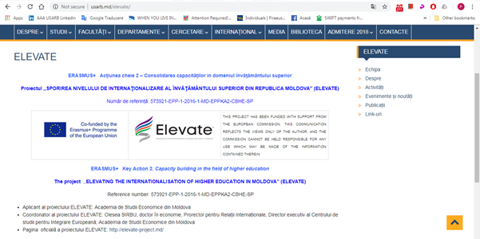
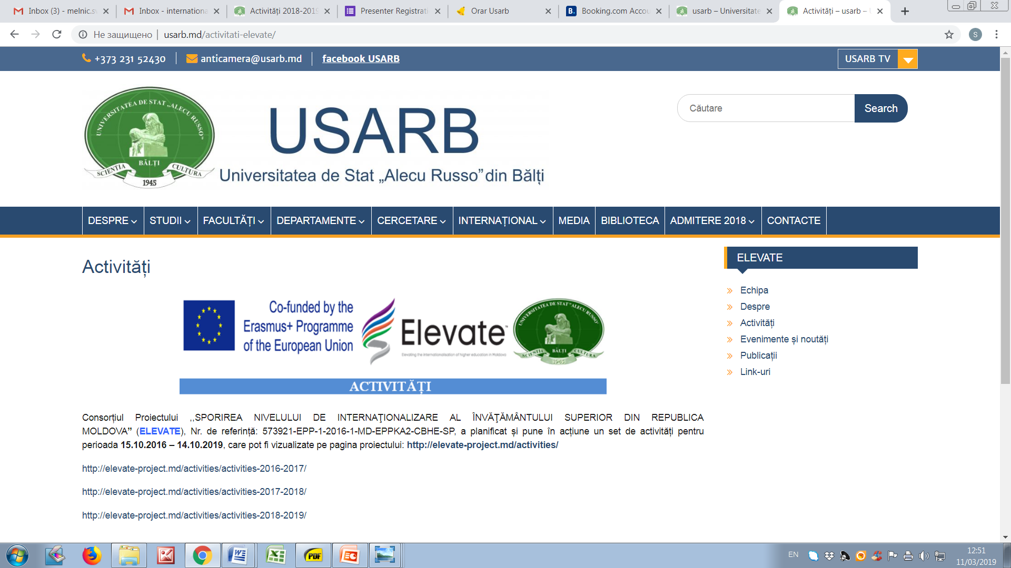
USARB Dissemination

Slide 10
DISSEMINATION ACTIVITY V
USARB Dissemination
Dissemination activity (e.g. workshop, conference, exhibition, etc.) | The Fair of the Erasmus + CBHE projects at USARB. Dissemination of ELEVATE project via The Fair of the Erasmus + CBHE projects at USARB
Date and place | October 4, 2018 Alecu Russo Balti State University (USARB)
Name and title of the person participated | Natalia GASITOI, Rector, PhD, Associate Professor; Valentina PRITCAN, Vice-Rector for Research and International Relations, PhD, Associate Professor, institutional project coordinator.
Attachment: please attach any material used (presentation, leaflet, project description, photos etc.) | USARB web page: https://media.usarb.md/2018/10/06/targul-proiectelor-erasmus-in-usarb/ USARB Facebook page: https://www.facebook.com/usarb.balti/photos/pcb.2260922340805713/2260920774139203/?type=3&theater

Slide 11
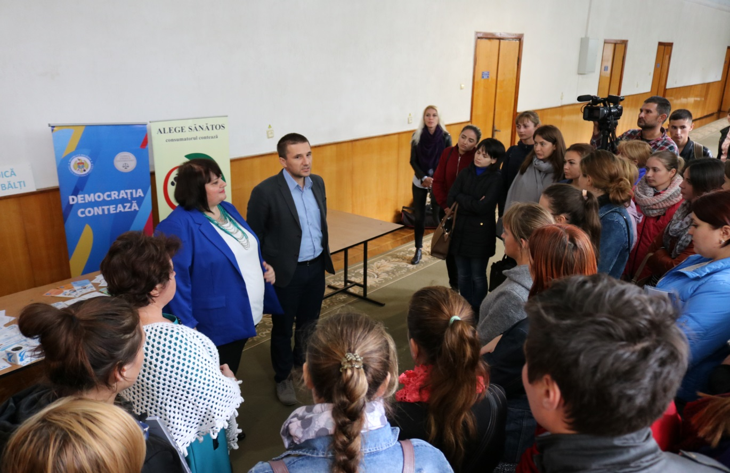
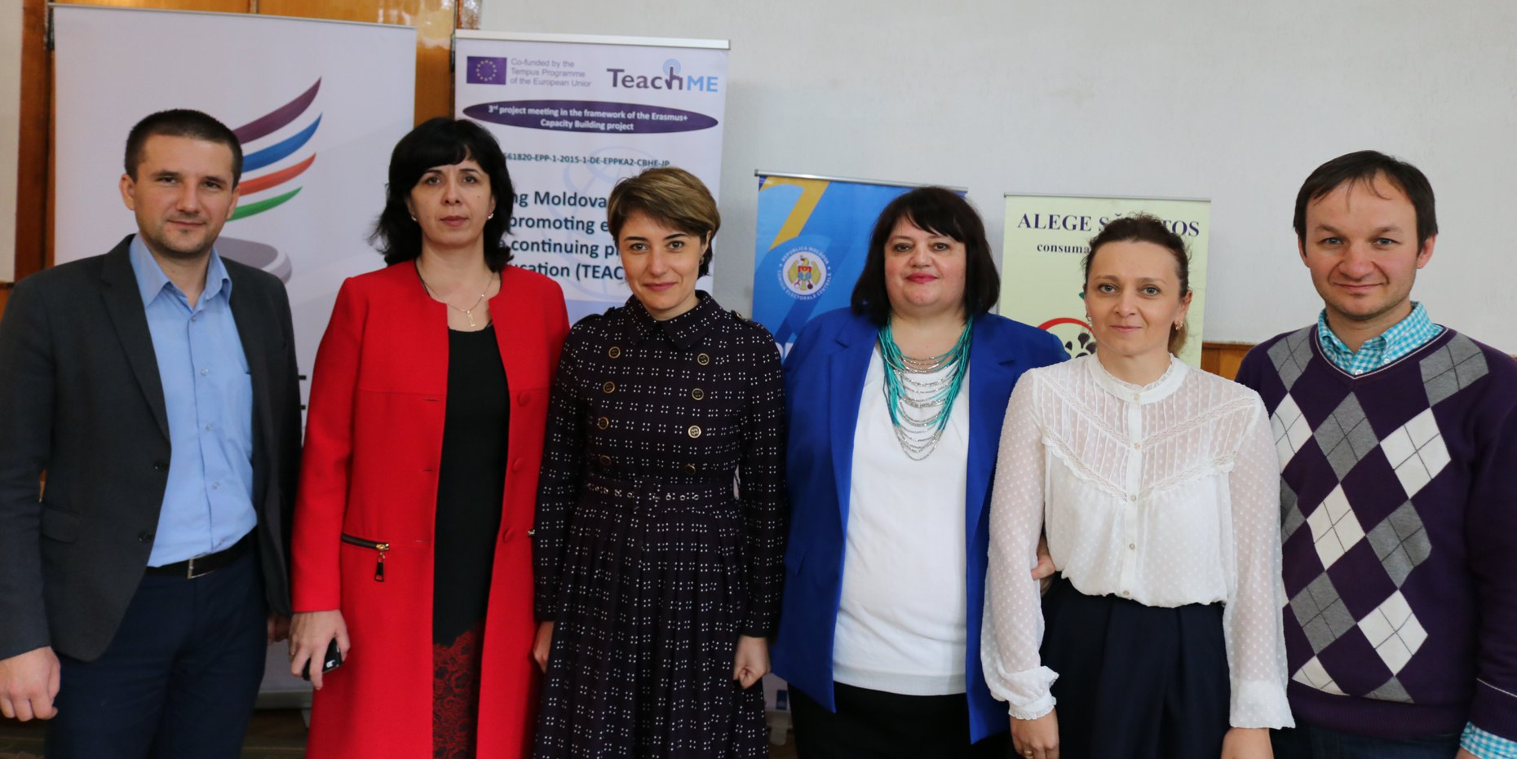
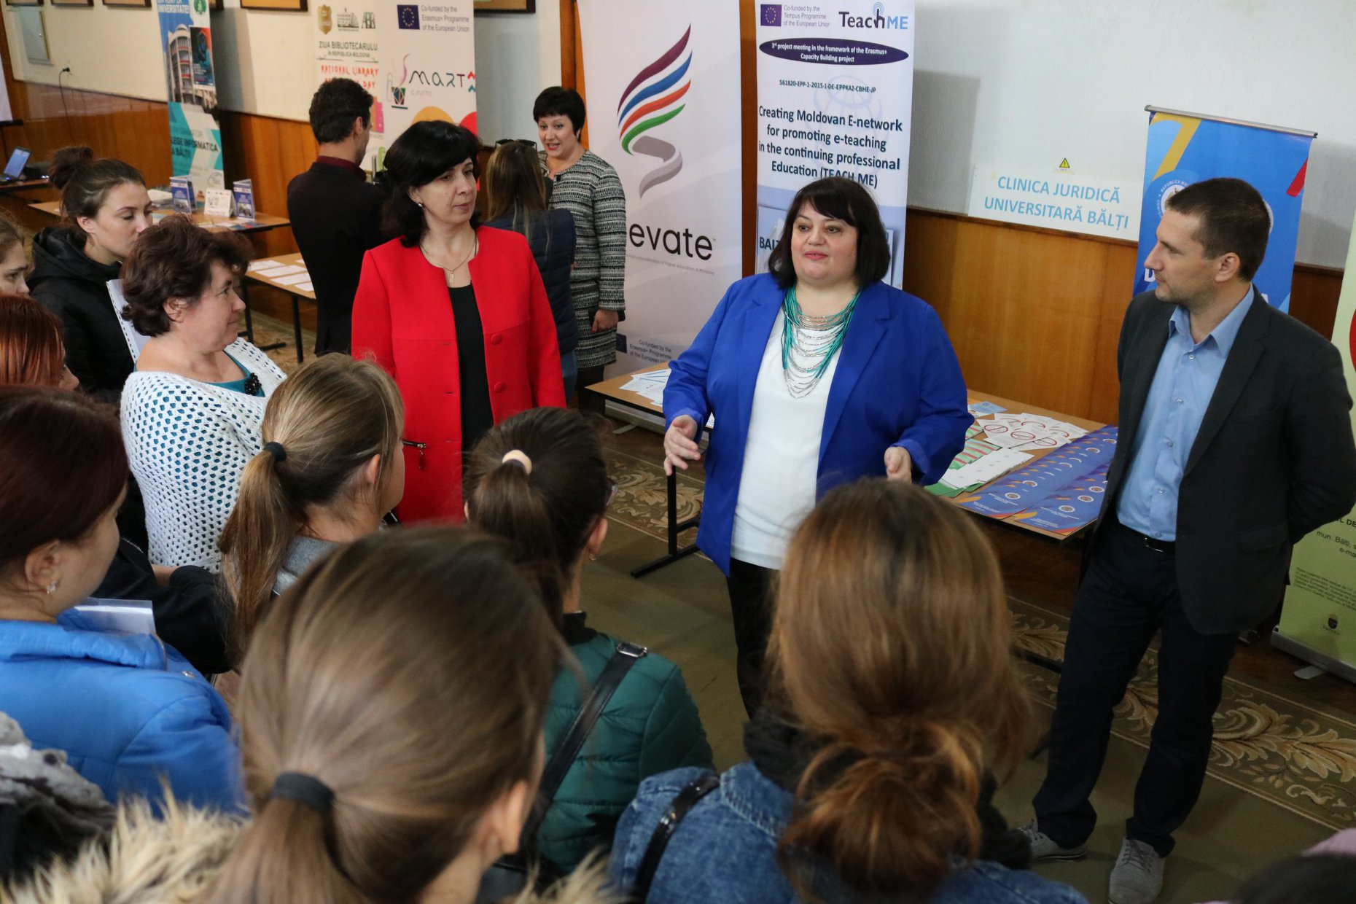
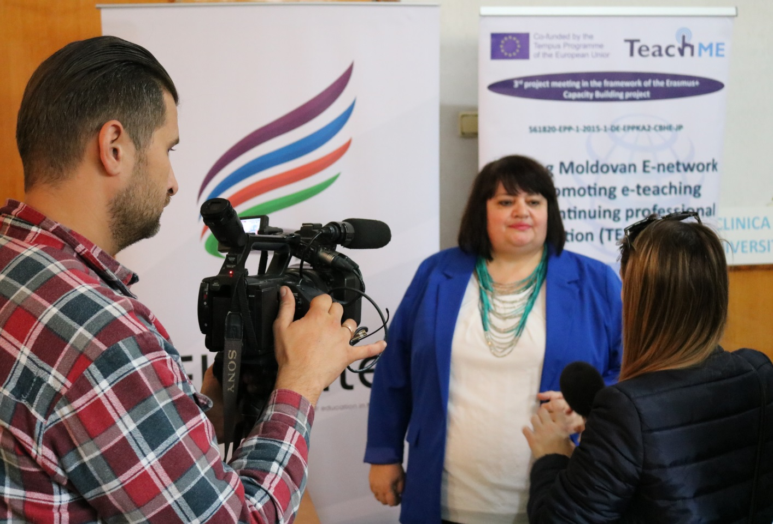
USARB Dissemination

Slide 12
DISSEMINATION ACTIVITY VI
USARB Dissemination
Dissemination activity (e.g. workshop, conference, exhibition, etc.) | ELEVATE Workshop at COLLOQUIA PROFESSORUM, USARB
Date and place | October 12, 2018 USARB
Name and title of the person participated | Natalia GASITOI, Rector, PhD, Associate Professor; Lidia PADUREAC, Prime Vice-rector for didactic activity; Valentina PRITCAN, Vice-rector for research and international relations PhD, Associate Professor, institutional project coordinator.
Attachment: please attach any material used (presentation, leaflet, project description, photos etc.) | USARB web page: https://media.usarb.md/2018/10/09/colloquia-professorum/ https://media.usarb.md/wp-content/uploads/2018/10/PROGRAM-COLLOQUIA-PROFESSORUM-2018-II-var..pdf https://media.usarb.md/2018/10/13/colloquia-professorum-editia-a-viii-a/ USARB Facebook page: https://www.facebook.com/usarb.balti/photos/pcb.2264603917104222/2264603400437607/?type=3&theater

Slide 13
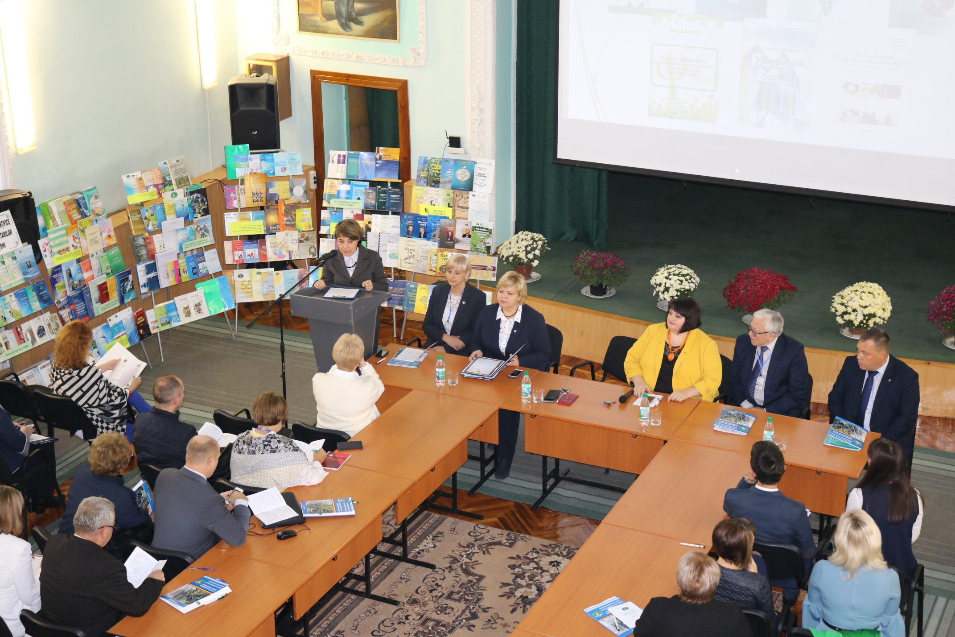
USARB Dissemination

Slide 14
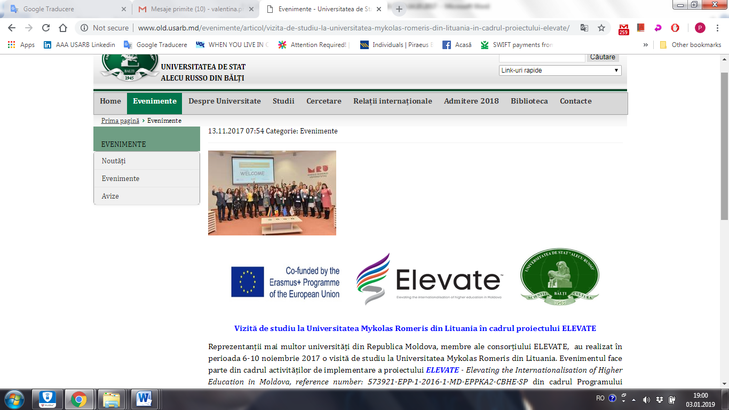
ADDITIONAL DISSEMINATION ACTIVITIES
USARB Dissemination
All study visits, conducted between 15.10.2017-14.10.2018, were reflected on the USARB web page and on the USARB Facebook page
1. Study visit to Mykolas Romeris University, Lithuania within the ELEVATE Project
http://www.old.usarb.md/evenimente/articol/vizita-de-studiu-la-universitatea-mykolas-romeris-din-lituania-in-cadrul-proiectului-elevate/

Slide 15
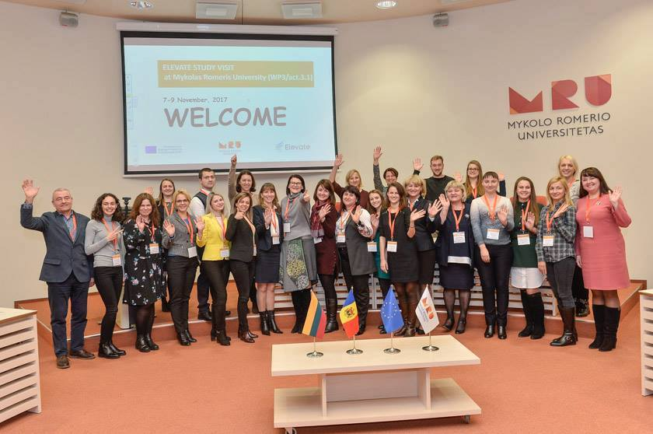
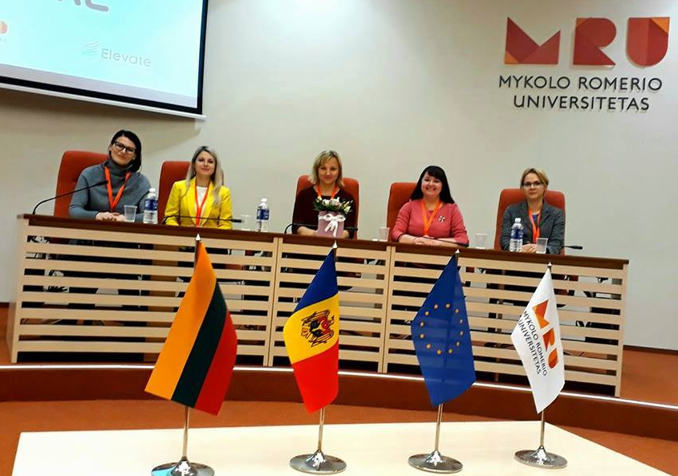
ADDITIONAL DISSEMINATION ACTIVITIES
USARB Dissemination
https://www.facebook.com/pg/universitatea.alecu.russo/photos/?tab=album&album_id=1504395982948765

Slide 16
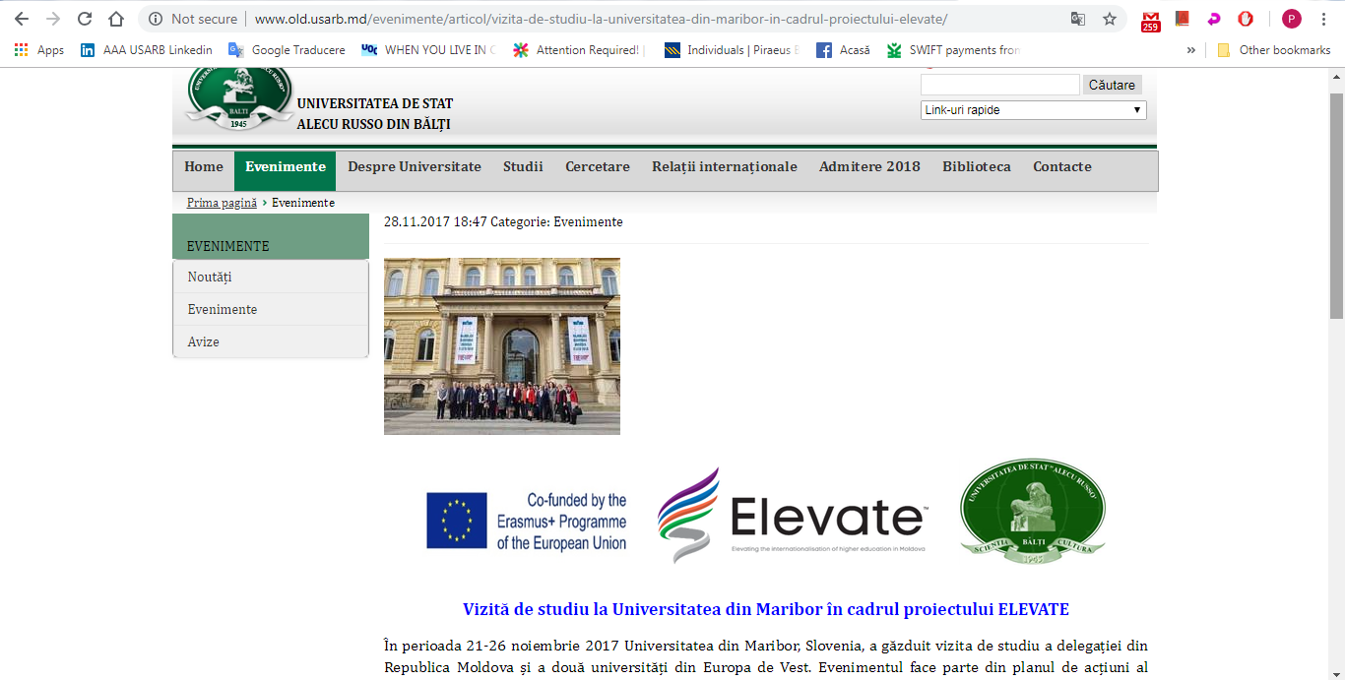
ADDITIONAL DISSEMINATION ACTIVITIES
USARB Dissemination
2. Study visit to University of Maribor, Slovenia within the ELEVATE Project
http://www.old.usarb.md/evenimente/articol/vizita-de-studiu-la-universitatea-din-maribor-in-cadrul-proiectului-elevate/

Slide 17
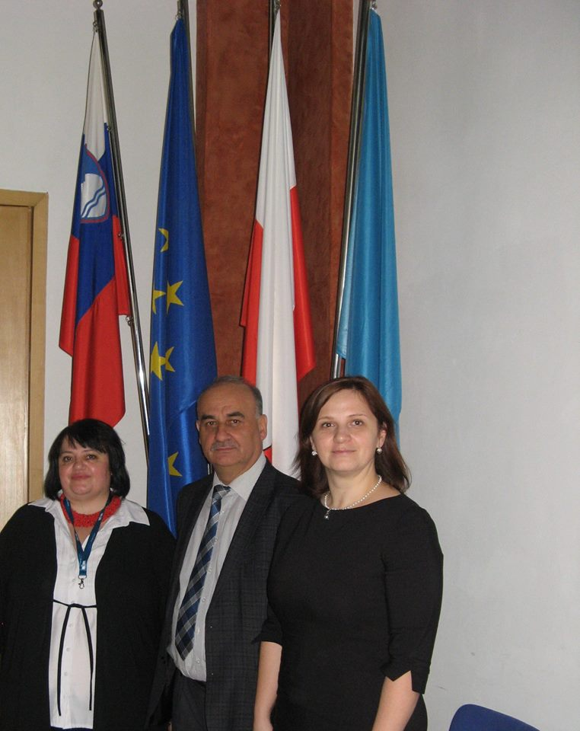
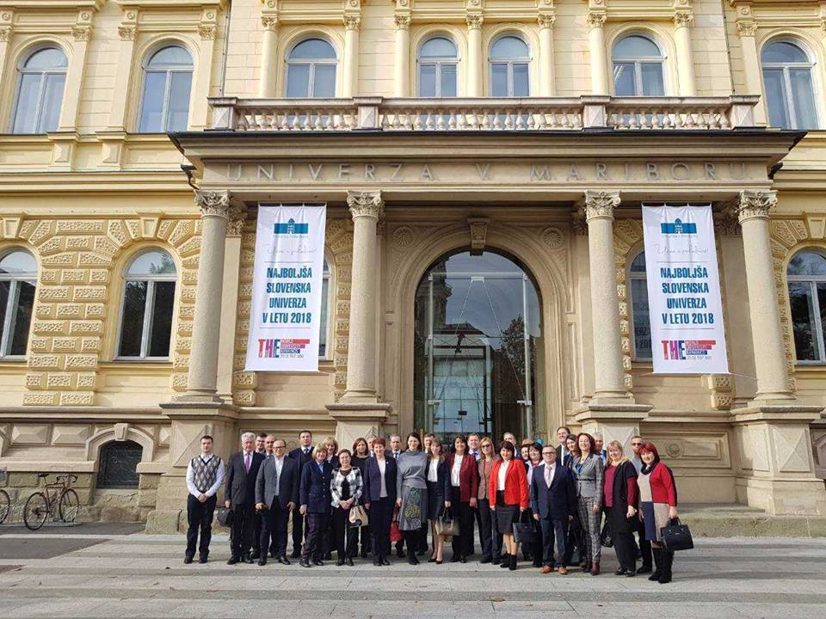
ADDITIONAL DISSEMINATION ACTIVITIES
USARB Dissemination
https://www.facebook.com/pg/universitatea.alecu.russo/photos/?tab=album&album_id=1521320081256355

Slide 18
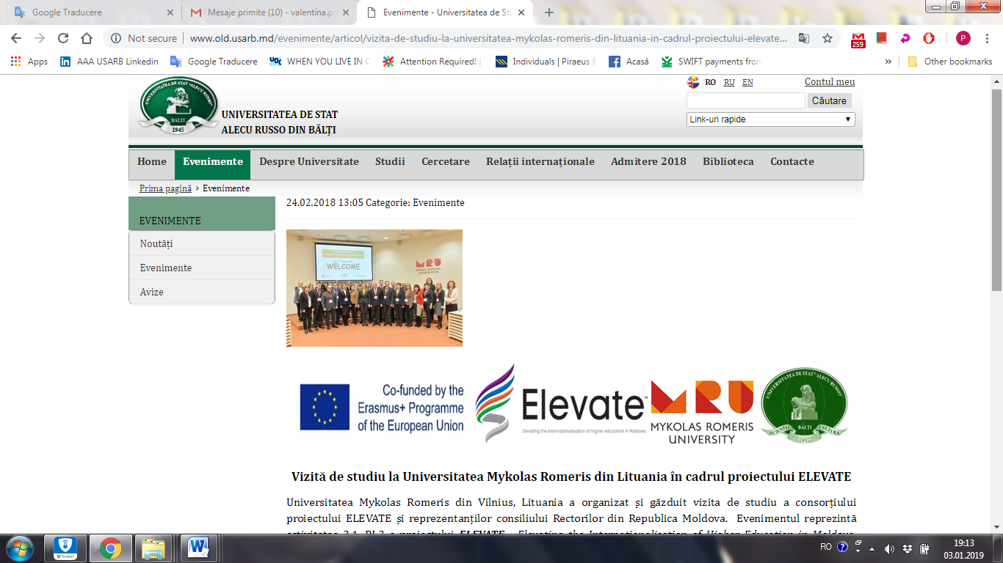
ADDITIONAL DISSEMINATION ACTIVITIES
USARB Dissemination
3. Study visit to Mykolas Romeris University, Lithuania within the ELEVATE Project
http://www.old.usarb.md/evenimente/articol/vizita-de-studiu-la-universitatea-mykolas-romeris-din-lituania-in-cadrul-proiectului-elevate-1/

Slide 19
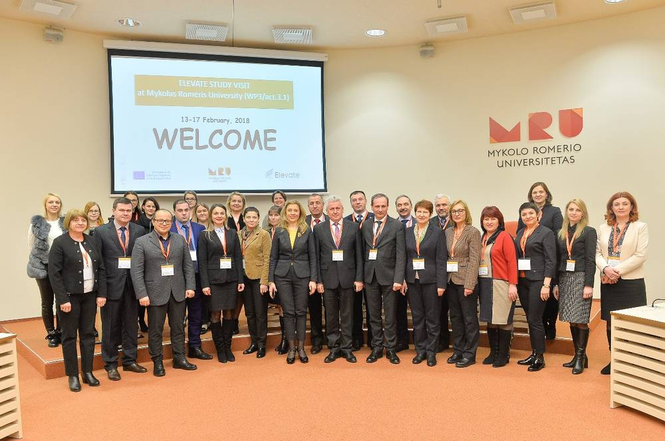
ADDITIONAL DISSEMINATION ACTIVITIES
USARB Dissemination

Slide 20
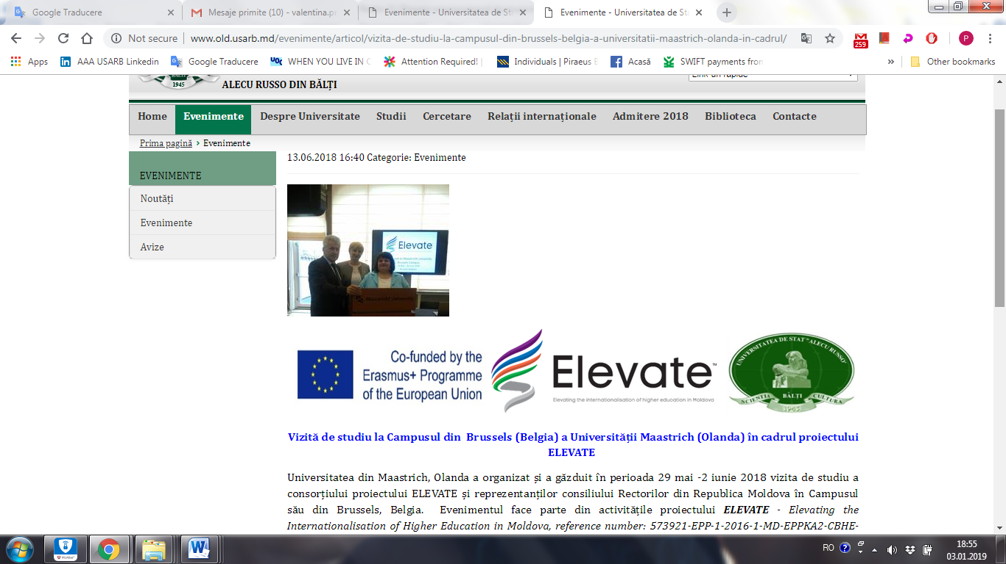
ADDITIONAL DISSEMINATION ACTIVITIES
USARB Dissemination
4. Study visit to the Campus of Brussels (Belgium) of the University of Maastrich, Netherlands within the ELEVATE Project
http://www.old.usarb.md/evenimente/articol/vizita-de-studiu-la-campusul-din-brussels-belgia-a-universitatii-maastrich-olanda-in-cadrul/

Slide 21
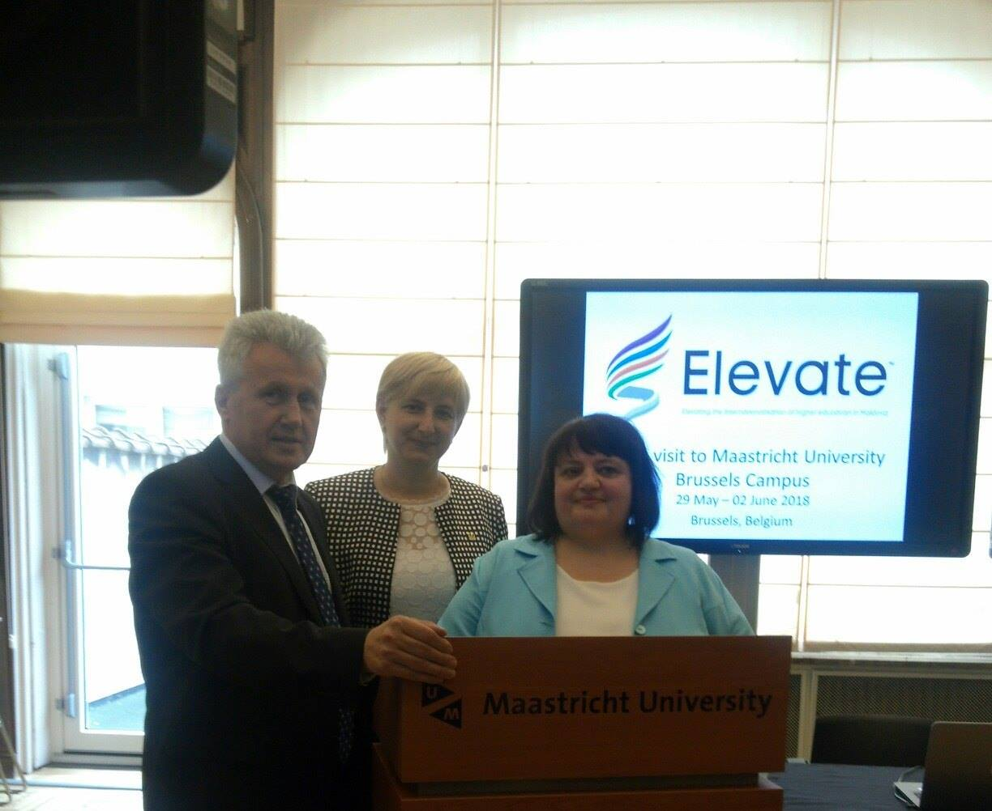
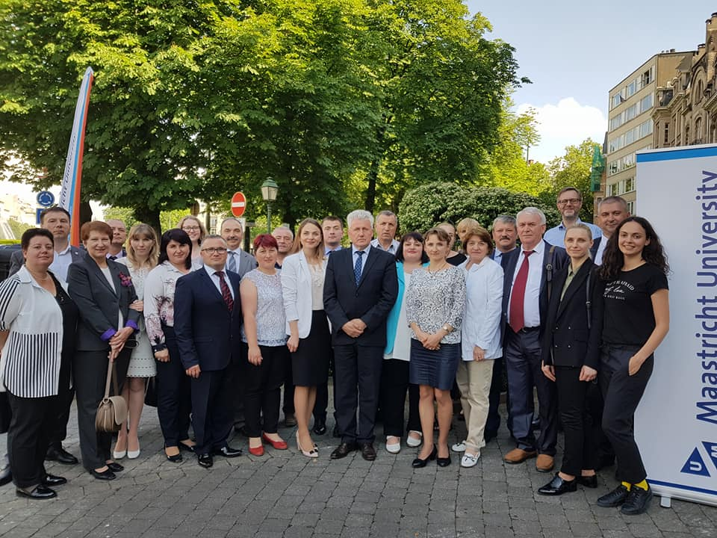
ADDITIONAL DISSEMINATION ACTIVITIES
USARB Dissemination
https://www.facebook.com/usarb.balti/photos/pcb.2160112724220009/2160112367553378/?type=3&theater

Slide 22
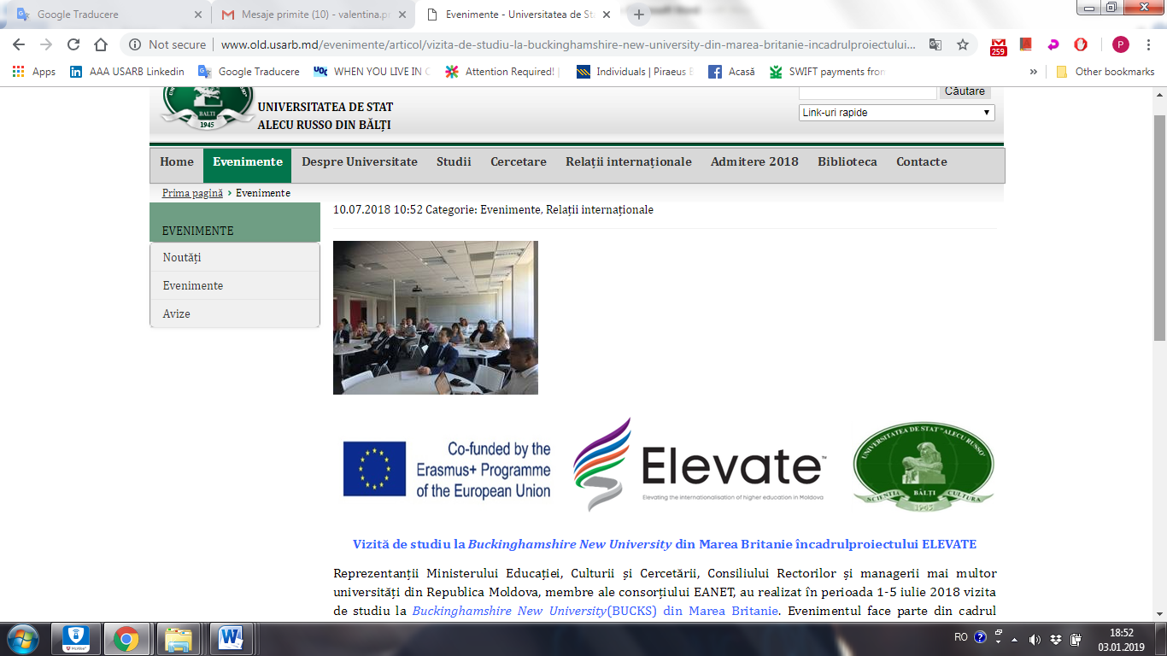
ADDITIONAL DISSEMINATION ACTIVITIES
USARB Dissemination
5. Study visit to Buckinghamshire New University, UK within the ELEVATE Project
http://www.old.usarb.md/evenimente/articol/vizita-de-studiu-la-buckinghamshire-new-university-din-marea-britanie-incadrulproiectului-elevate/

Slide 23
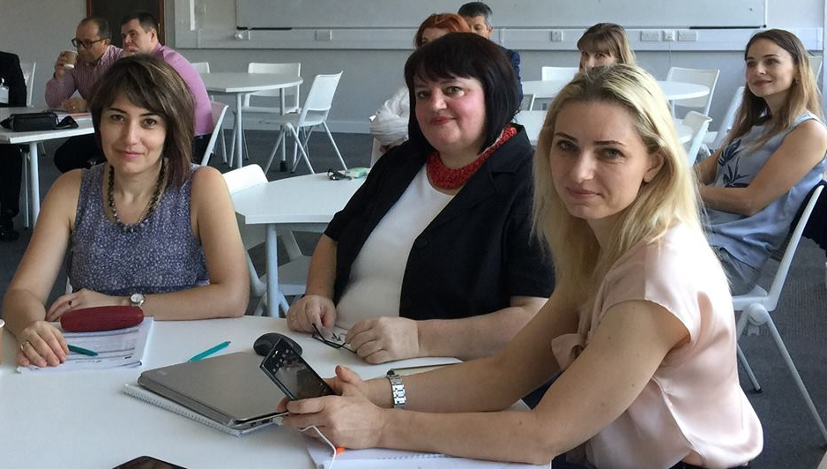
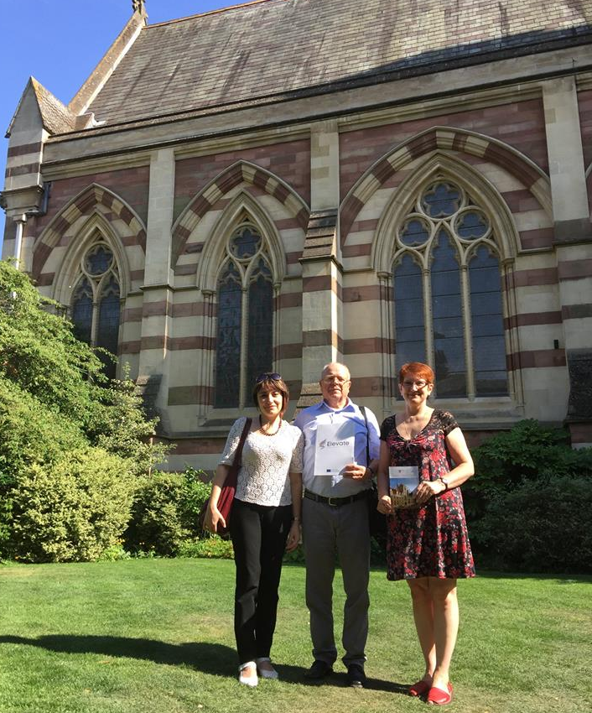
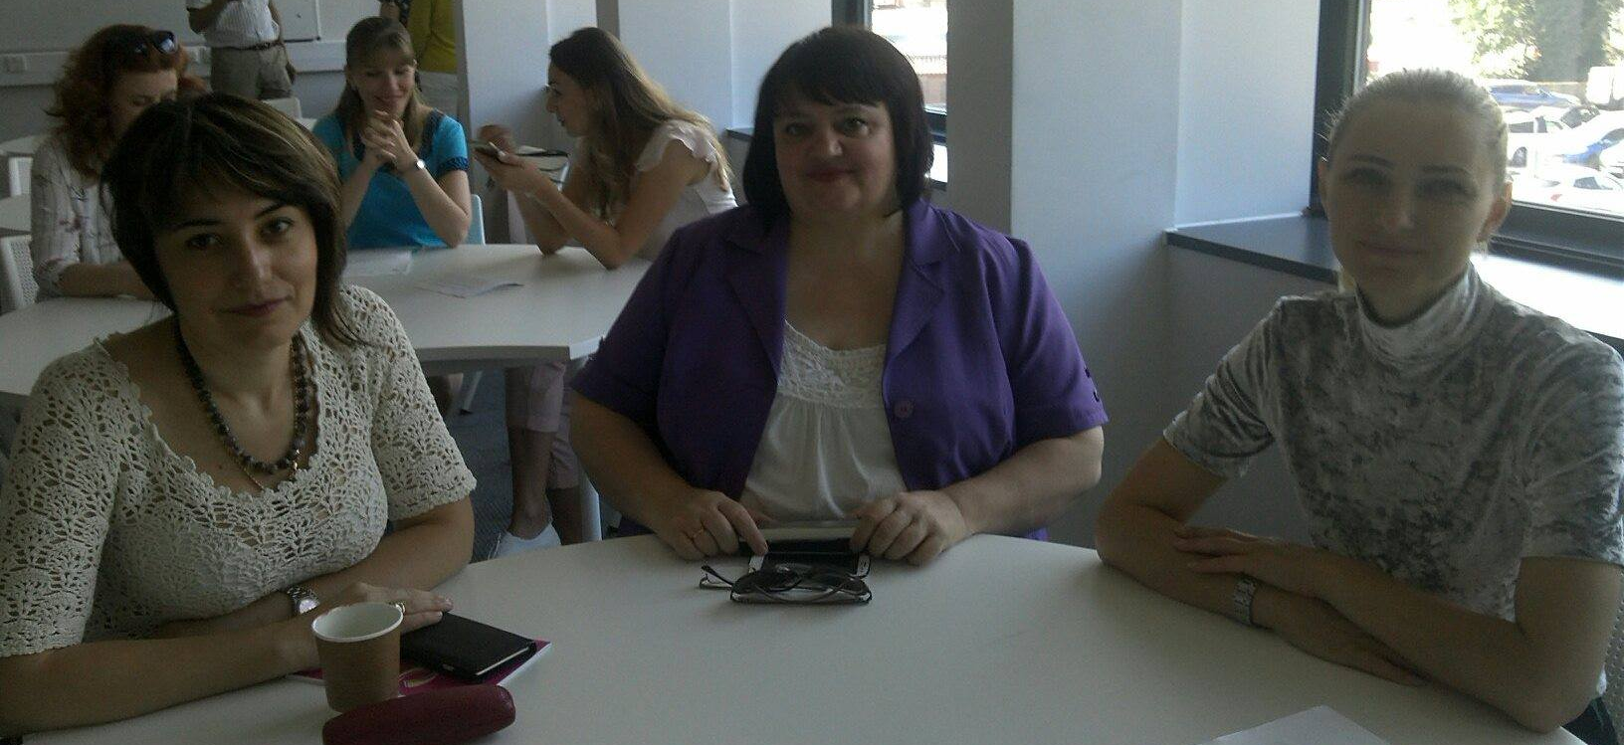
ADDITIONAL DISSEMINATION ACTIVITIES
USARB Dissemination
https://www.facebook.com/usarb.balti/photos/pcb.2186161131615168/2186160341615247/?type=3&theater

Slide 24
USARB Dissemination
INDIVIDUAL DISSEMINATION CALENDAR
Partner Name | P4, Alecu Russo Balti State University (USARB)
Period | 15/10/2018 - 14/10/2019

Slide 25
INSTITUTIONAL LEVEL
USARB Dissemination
Institutional dissemination seminar/workshop
Presentation of the activities of the project at meetings of the USARB administrative Council and USARB Administrative staff.
Presentation of the ELEVATE Project in the Europe Days 2019 at USARB
Workshop. Internationalization and Quality of Education and Research.
The role of ICM in the USARB internationalization
The Fair of the Erasmus + CBHE projects at USARB
Dissemination of ELEVATE project via The Fair of the Erasmus + CBHE projects at USARB
ELEVATE Institutional electronic Newspaper N 3
Permanent update a ELEVATE project page on the USARB website

Slide 26
NATIONAL LEVEL
USARB Dissemination
Information days and public appearances
Presentation of the ELEVATE Project in the days of Europe.
National Conferences/ Workshops/ Seminars
Participation in National Conferences / Workshops / Seminars on topics related to the process of internationalization of Higher Education in Moldova
Mass-media appearance (TV, radio, articles in mass-media)
Interviews / press releases on topics related to the consolidation of the processes of internationalization of Higher Education in Moldova through the ELEVATE project

Slide 27
INTERNATIONAL LEVEL
USARB Dissemination
International Conference/Articles
Participation in International Conferences / Workshops / Seminars on topics related to the process of internationalization of Higher Education in Moldova

Slide 28
USARB Dissemination
Thank you for your attention !

