Slide 1
P4, Alecu Russo Balti State University (USARB)
Session I: ELEVATE project`s development achievements and results
WP 2,3,4 Development
Valentina PRITCAN
Vice-rector for research and international relations,
Institutional coordinator of the ELEVATE project
Project No. 573921-EPP-1-2016-1-MD-EPPKA2-CBHE-SP
Project title: “ELEVATING THE INTERNATIONALISATION OF HIGHEREDUCATION IN MOLDOVA – ELEVATE”
Title of the event: Third consortium meeting (cm3)
Period: 12-13 March 2019
Venue: Academy of Economic Studies of Moldova (61, Banulescu- Bodoni str., Building A, 3rd floor, Senate room, Chisinau, Republic of Moldova

Slide 2
INTERNATIONALIZATION STRATEGY OF ALECU RUSSO BALTI STATE UNIVERSITY (2018-2023)
Internationalization at USARB
APPROVED | USARB Senate, Minutes No. 5 of 28.11.2018 | RECTOR | _______________ PhD, Ass. Prof. Natalia GAȘIȚOI | 28.11.2018
VERIFIED | The Committee for Projects and Partnership Relations of USARB Senate | Committee Chairperson | _______________ PhD, Ass. Prof. Valentina PRIȚCAN | 23.11.2018
ELABORATED | ELEVATE Team | Vice-Rector for Research and International Relations | _____________ PhD, Ass. Prof. Valentina PRIȚCAN | 27.09.2018

Slide 3
INTERNATIONALIZATION STRATEGY OF ALECU RUSSO BALTI STATE UNIVERSITY (2018-2023)
Internationalization at USARB
The Internationalization Strategy is based on the components approved at the ELEVATE Consortium Meeting held at Maasticht University (Brussels): strategic priorities/ relevant areas, objectives, measures/ activities needed to achieve the objectives and expected results, expected results and progress indicators.
The actions are not ordered according to their priority, and the timetable may undergo changes in the annual operating plan in accordance with the national and international context.

Slide 4
INTERNATIONALIZATION STRATEGY OF ALECU RUSSO BALTI STATE UNIVERSITY (2018-2023)
Internationalization at USARB
Strategic Priority I - Development of the internal policy framework for ensuring the processes of internationalization of education and research within USARB.
General Objective: Recognizing the internationalization as a multilateral process of developing the quality of education and research.

Slide 5
Results achieved
Internationalization at USARB
The Operation Regulation of the DIR (Department of International Relations)
The Regulation of Mobility Organization
The Internationalization Strategy of USARB 2018-2023
Operational Plan

Slide 6
Key Action 1 Higher Education Student and Staff Mobility
Internationalization at USARB
Our Partners

Slide 7
Key Action 2 Capacity building in the field of higher education

Slide 8
Supporting the mobility of staff and students
Internationalization at USARB
Country, Institution |  |  | Number of people
Romania
 |  | Alexandru Ioan Cuza University of Iasi | 3
 |  | Ovidius University of Constanta | 1
 |  | Vasile Goldis West University of Arad | 1
Spain
 | University of Granada |  | 2
 | University of A Coruna |  | 3
Norway
 | Volda University College |  | 4
Greece
 | University of West Attica |  | 3
Italy
 | Alma Mater University of Bologna |  | 2
 | UNINETTUNO Telematic University of Rome |  | 2
Estonia
 | Narva College, University of Tartu |  | 1
Outgoing, Spring of 2018-2019

Slide 9
Supporting the mobility of staff and students
Internationalization at USARB
Country, Institution |  |  | Number of people
Romania
 |  | Pharmacy Medical University of Tirgu Mures | 1
 |  | Transilvania University of Brasov | 2
Spain
 | University of Almeria |  | 1
Italy
 | Alma Mater University of Bologna |  | 1
Estonia
 | Narva College, University of Tartu |  | 1
Incoming, Spring of 2018-2019

Slide 10
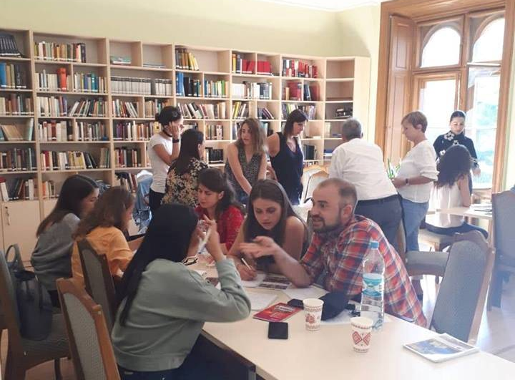
INTERNATIONAL PROJECTS
Internationalization at USARB
Media Beyond Frontiers –
implemented by the Institute for Culture and History of South East Europe (LMU München) in partnership with "Yuri Fedkovici" National University of Chernivtsi (Ukraine) and USARB and sponsored by the Federal Foreign Office of Germany.

Slide 11
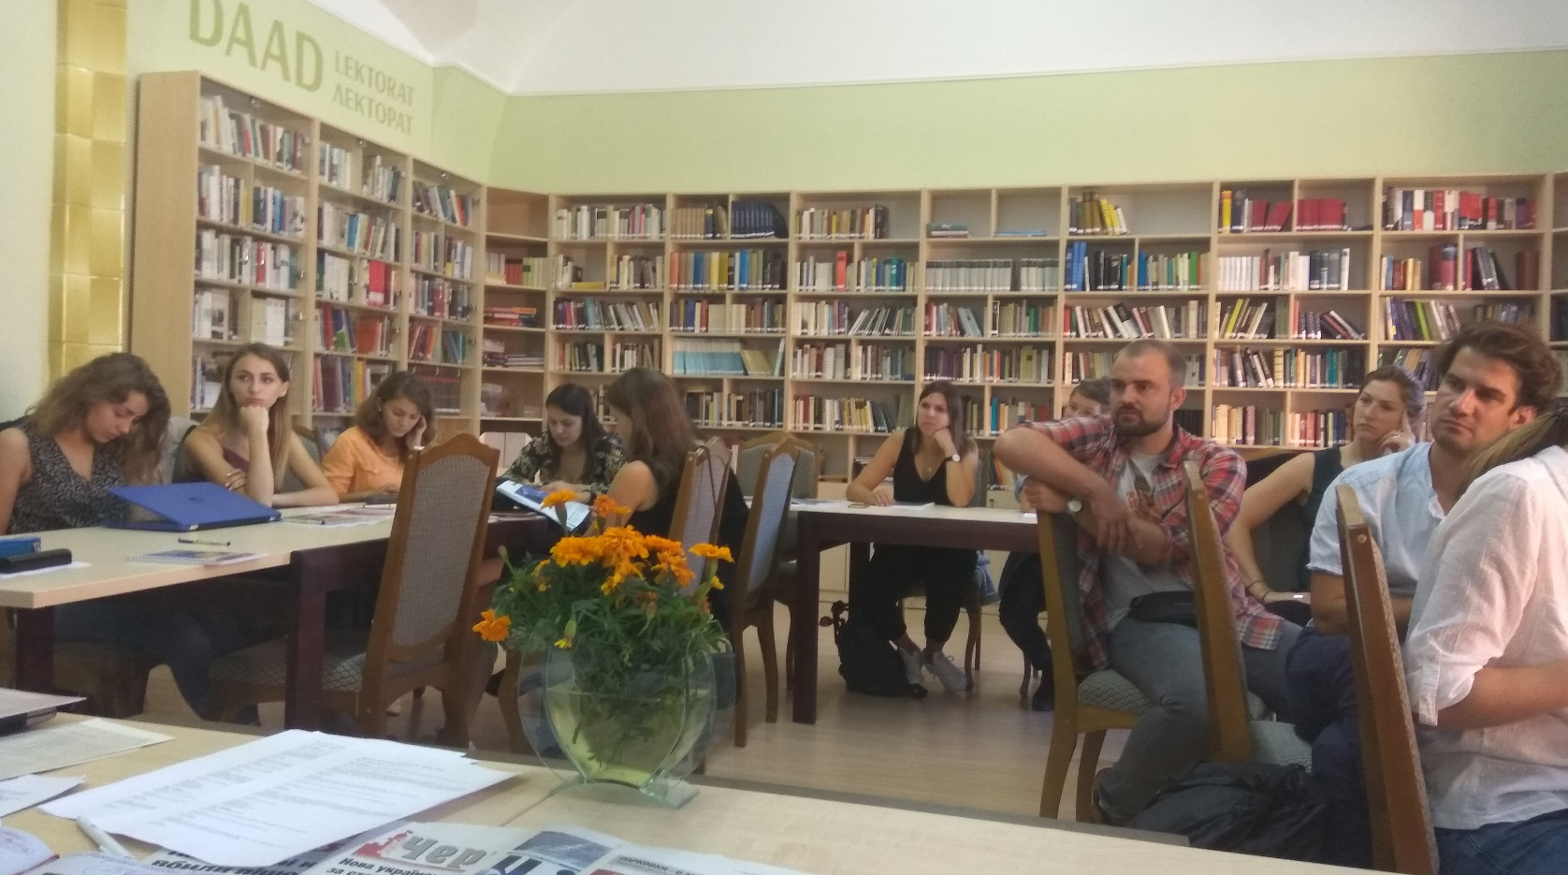
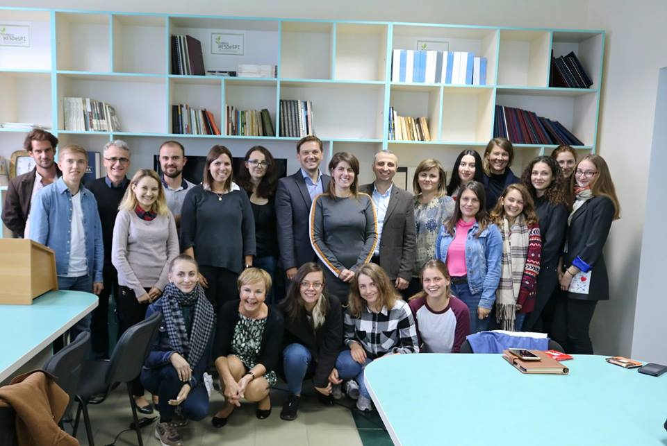
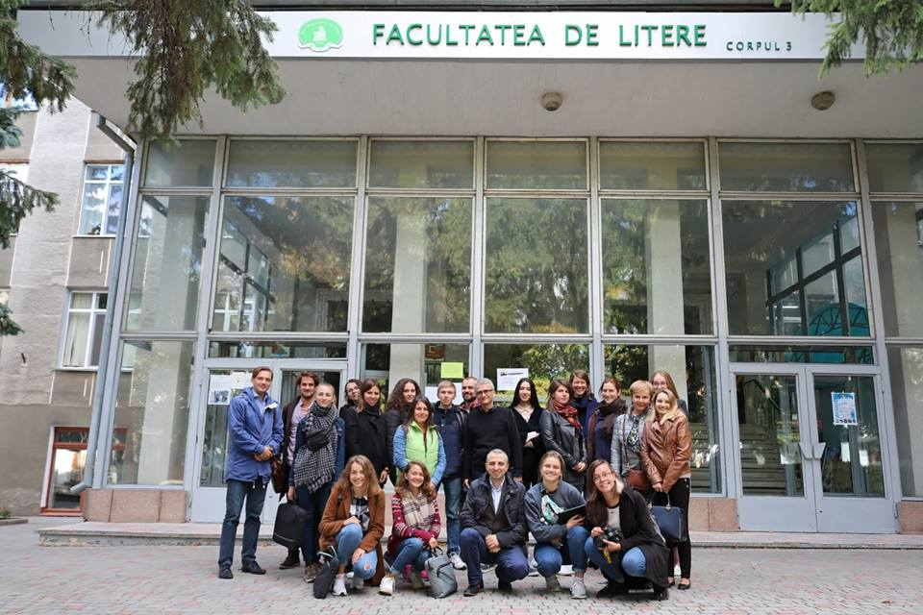
INTERNATIONAL PROJECTS
Internationalization at USARB
Media Beyond Frontiers

Slide 12
INTERNATIONAL PROJECTS
Internationalization at USARB
New Horizons of Internationalization
Malmö University, Swedish Institute
Yep! Moldova
together with international experts will help Moldovan students develop a business idea

Slide 13
Supporting the mobility of staff and students
Internationalization at USARB
Information and Support Sessions for students and staff submitting applications for ERASMUS +
26 October 2018 – for MA and PhD Students at 18:00, USARB Senate Hall
29 October 2018 – for BA Students at 15:00, USARB Senate Hal
31 October 2018 – for Staff at 15:00, USARB Senate Hall
2 November 2018 – for MA and PhD Students a 17:00, USARB Senate Hall

Slide 14
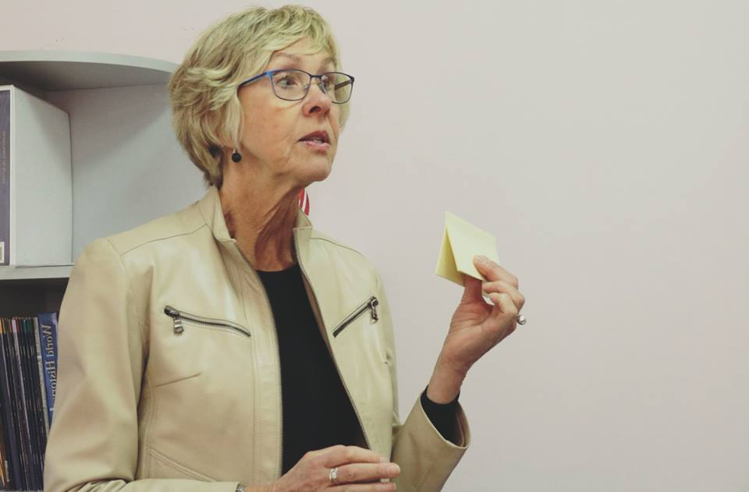
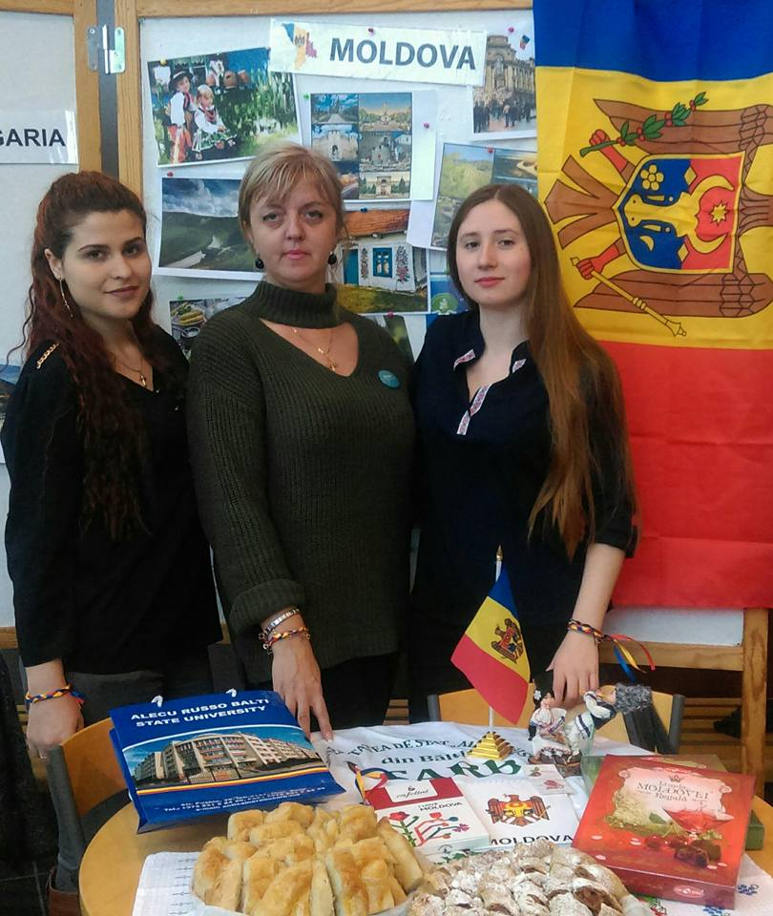
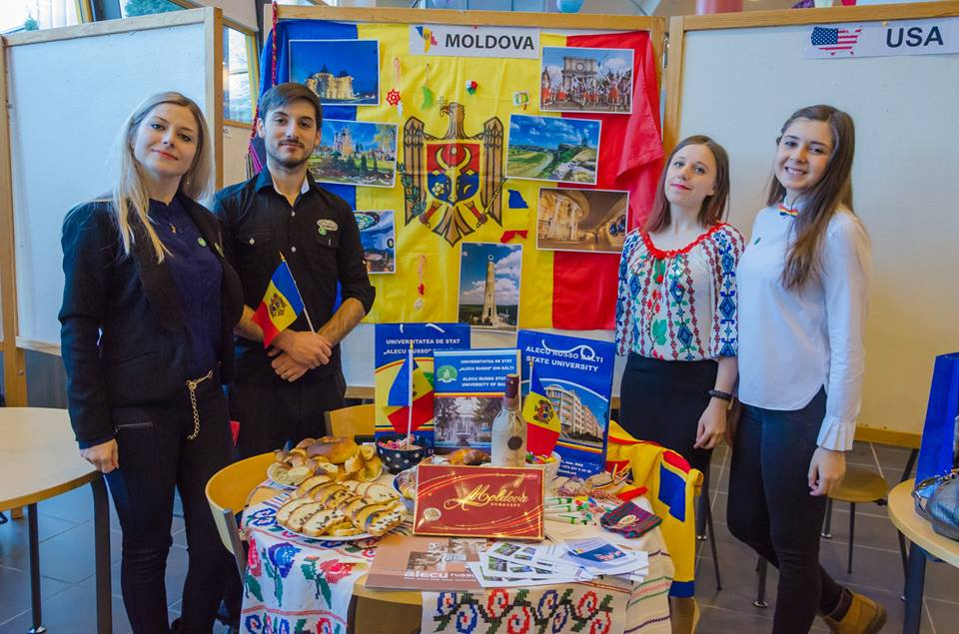
Internationalization at USARB
A story of success!

Slide 15
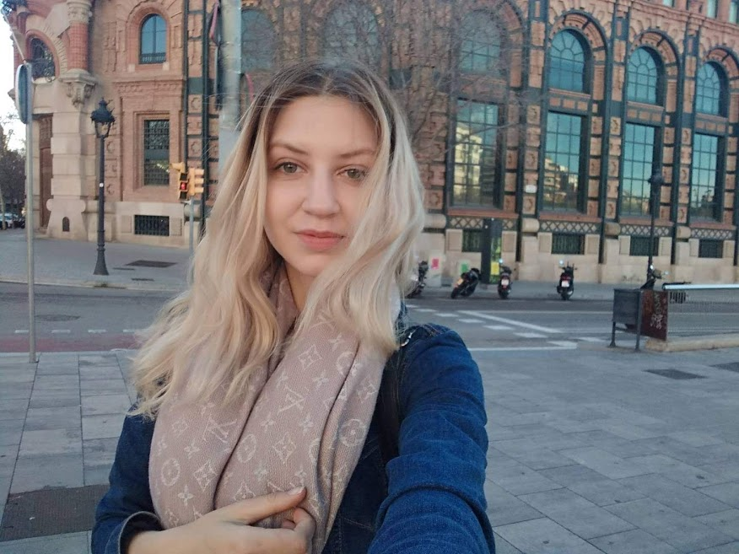
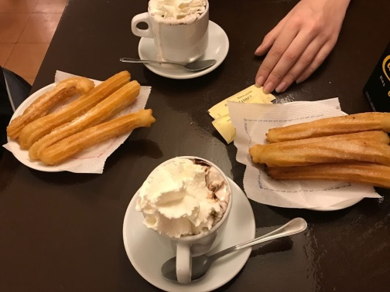
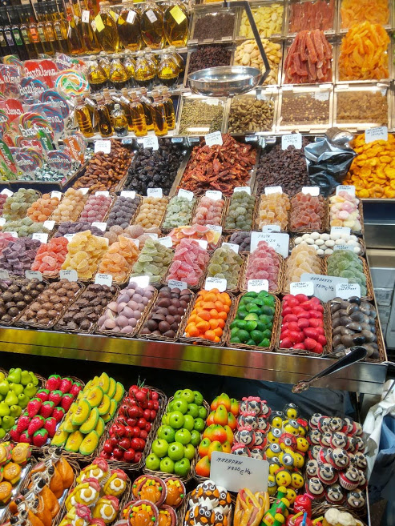
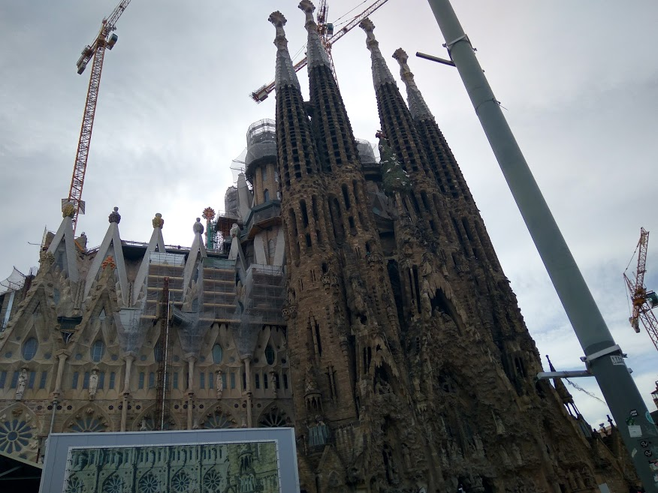
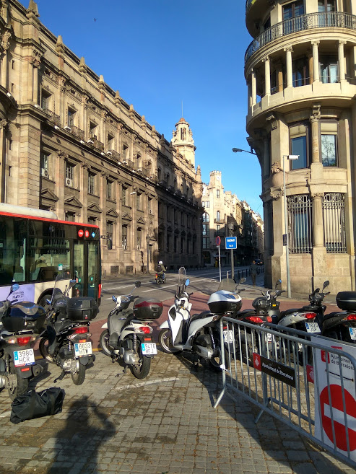
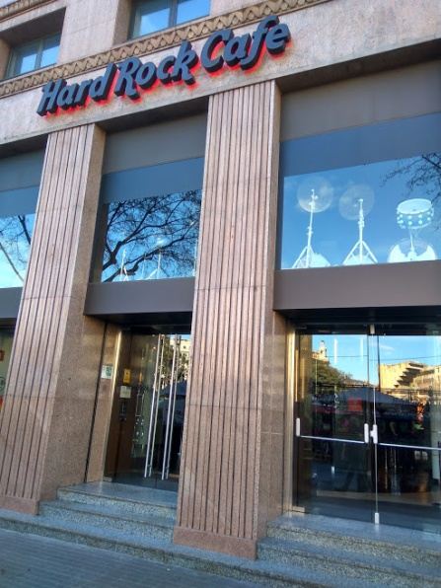
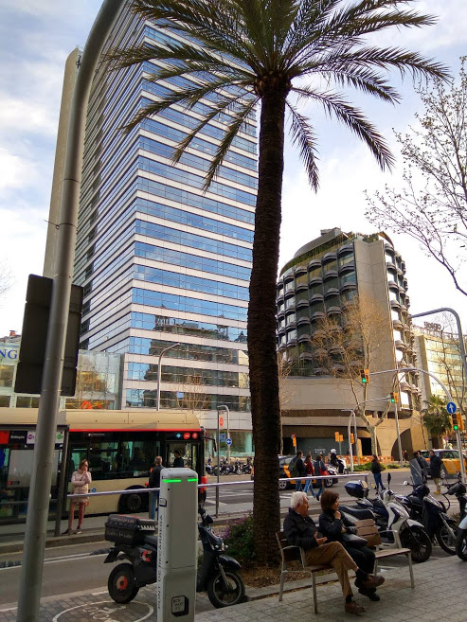
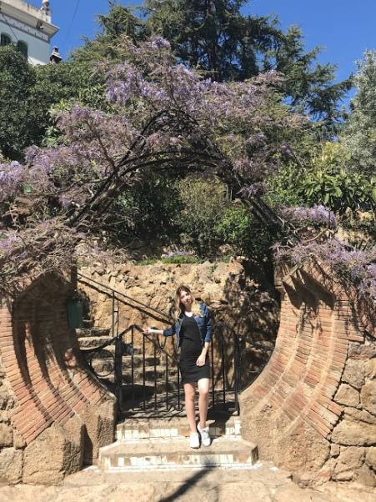
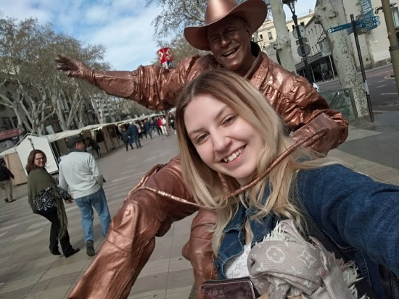
Internationalization at USARB
USARB Students

Slide 16
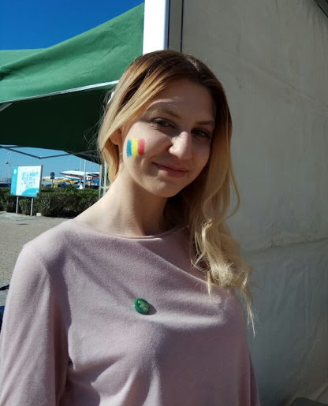
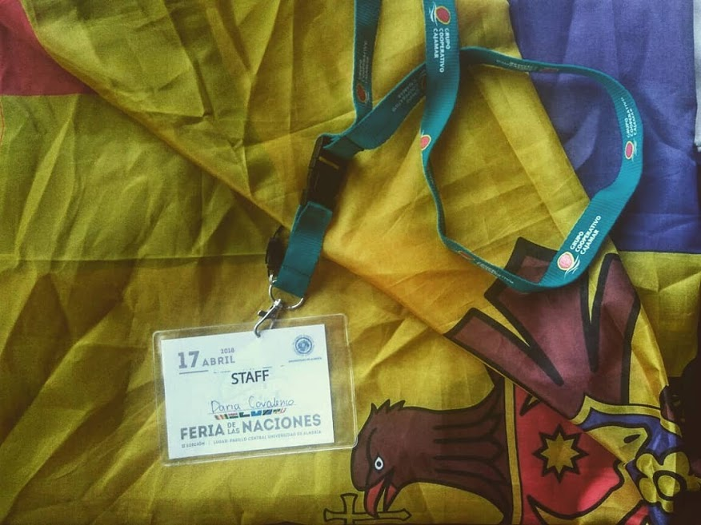
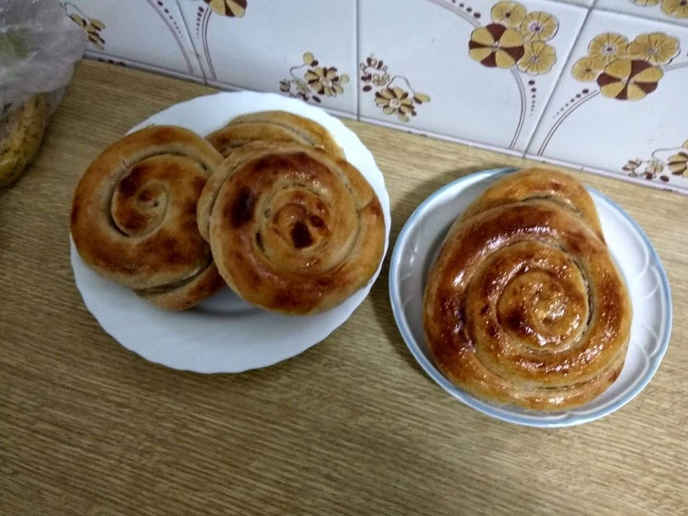
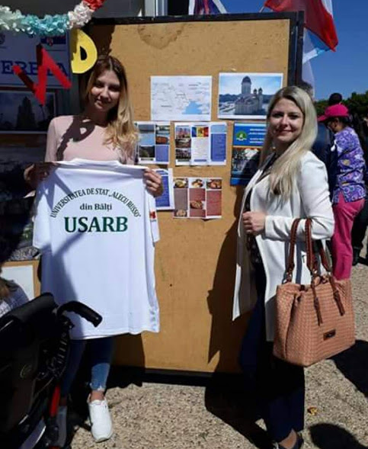
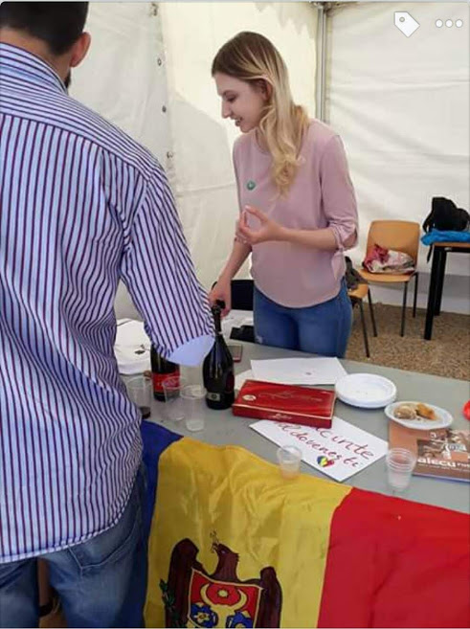
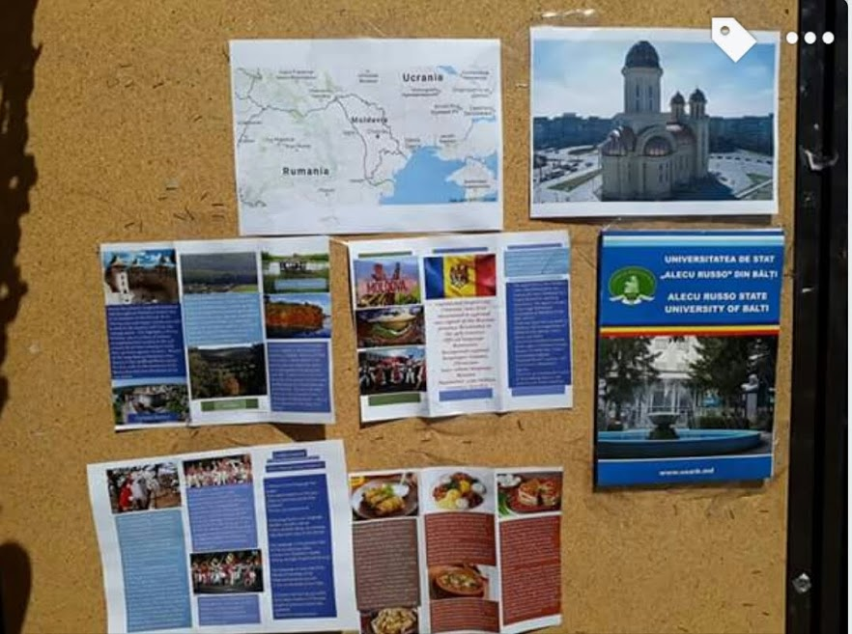
Internationalization at USARB

Slide 17
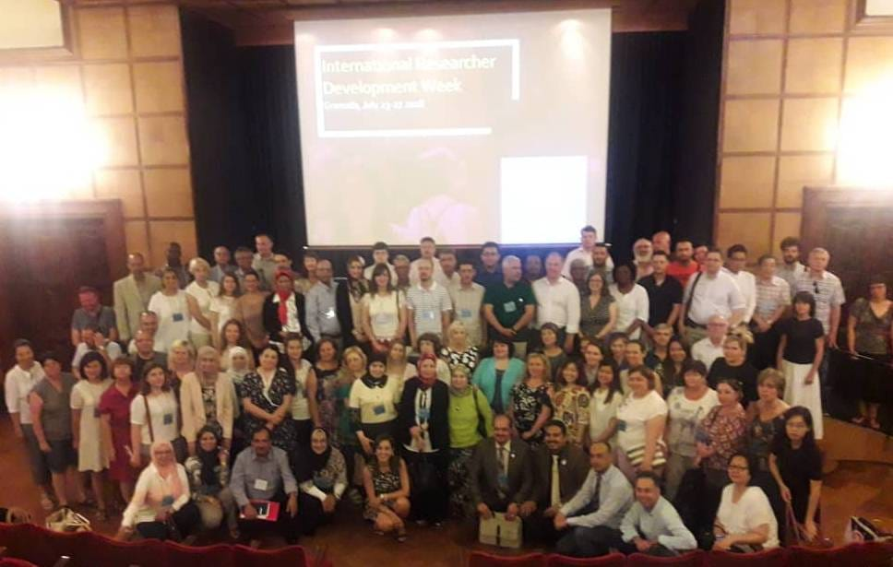
INTERNATIONAL EVENTS
Internationalization at USARB
The Capitalization of Internationalization via the International Research Development Week held at a Partner Institution (University of Granada, Spain)

Slide 18
INTERNATIONAL EVENTS at USARB
Internationalization at USARB
International Cultural Events
International Concerts
International Exhibitions
International Public Lectures, etc.

Slide 19
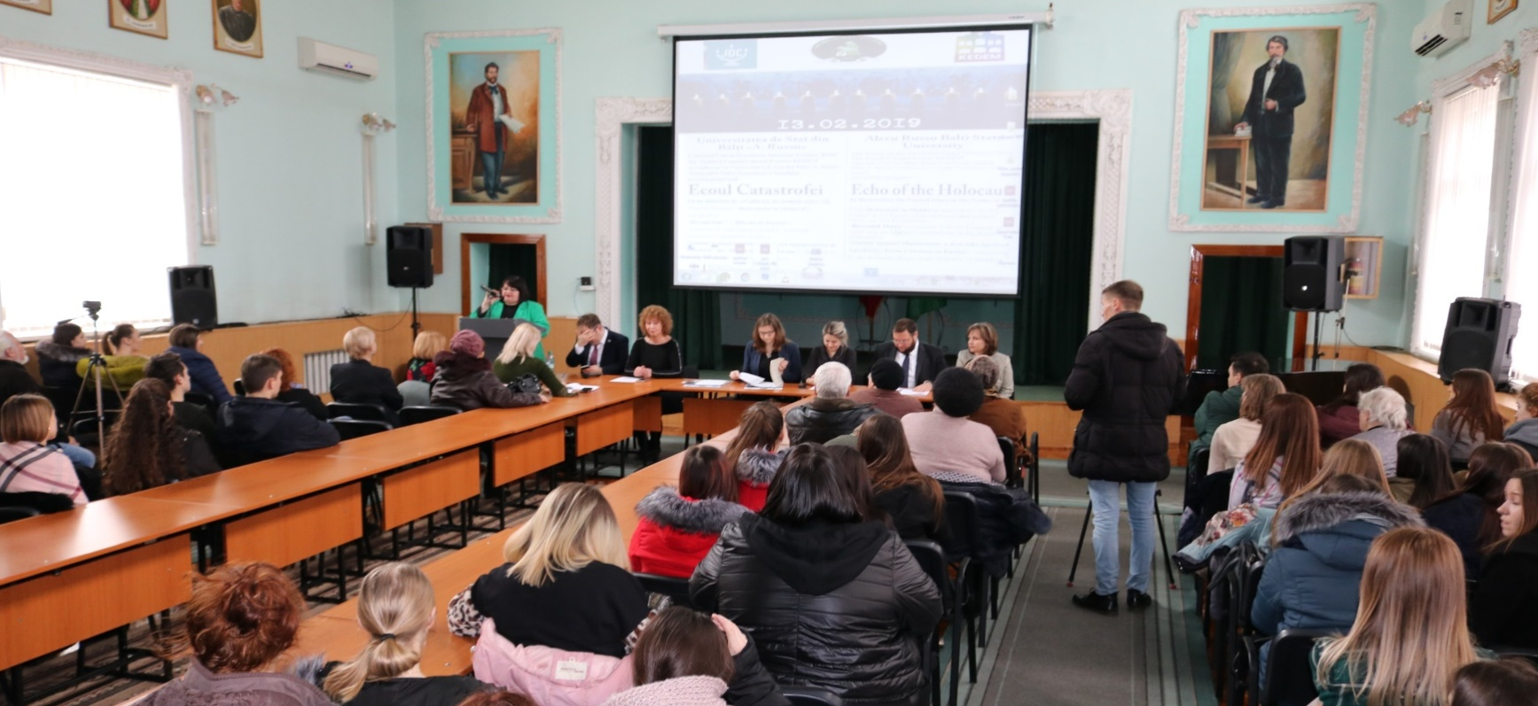
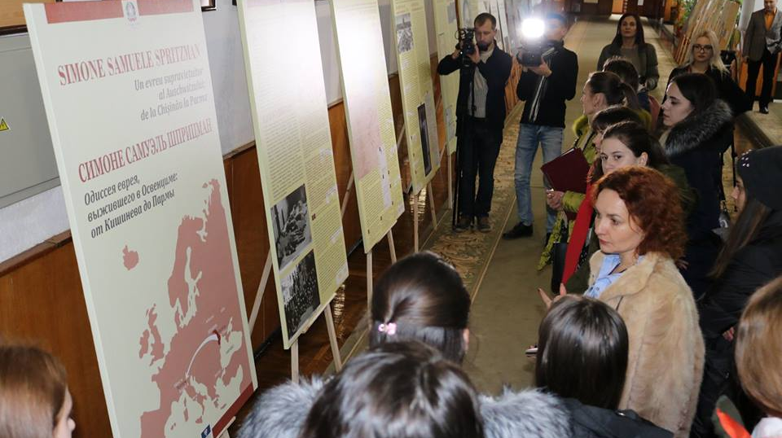
INTERNATIONAL EVENTS at USARB
Internationalization at USARB
The event was organized by the KEDEM Jewish Cultural Center in Chisinau, in partnership with USARB and the Embassies of Italy, Germany and Israel in Moldova

Slide 20
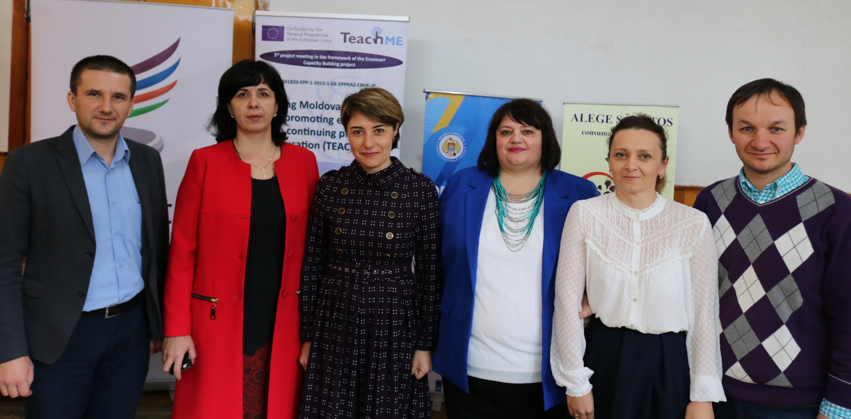
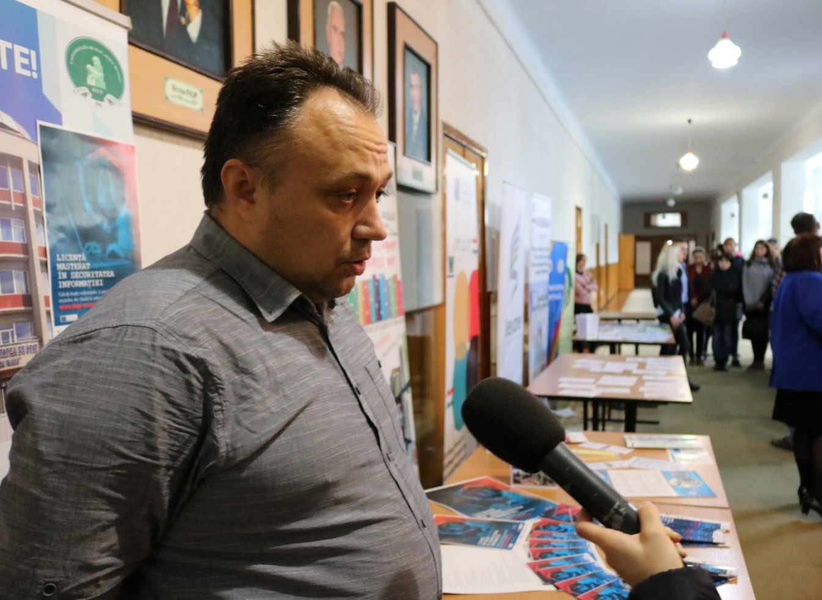
Fair of Erasmus + Projects at USARB
Internationalization at USARB

Slide 21
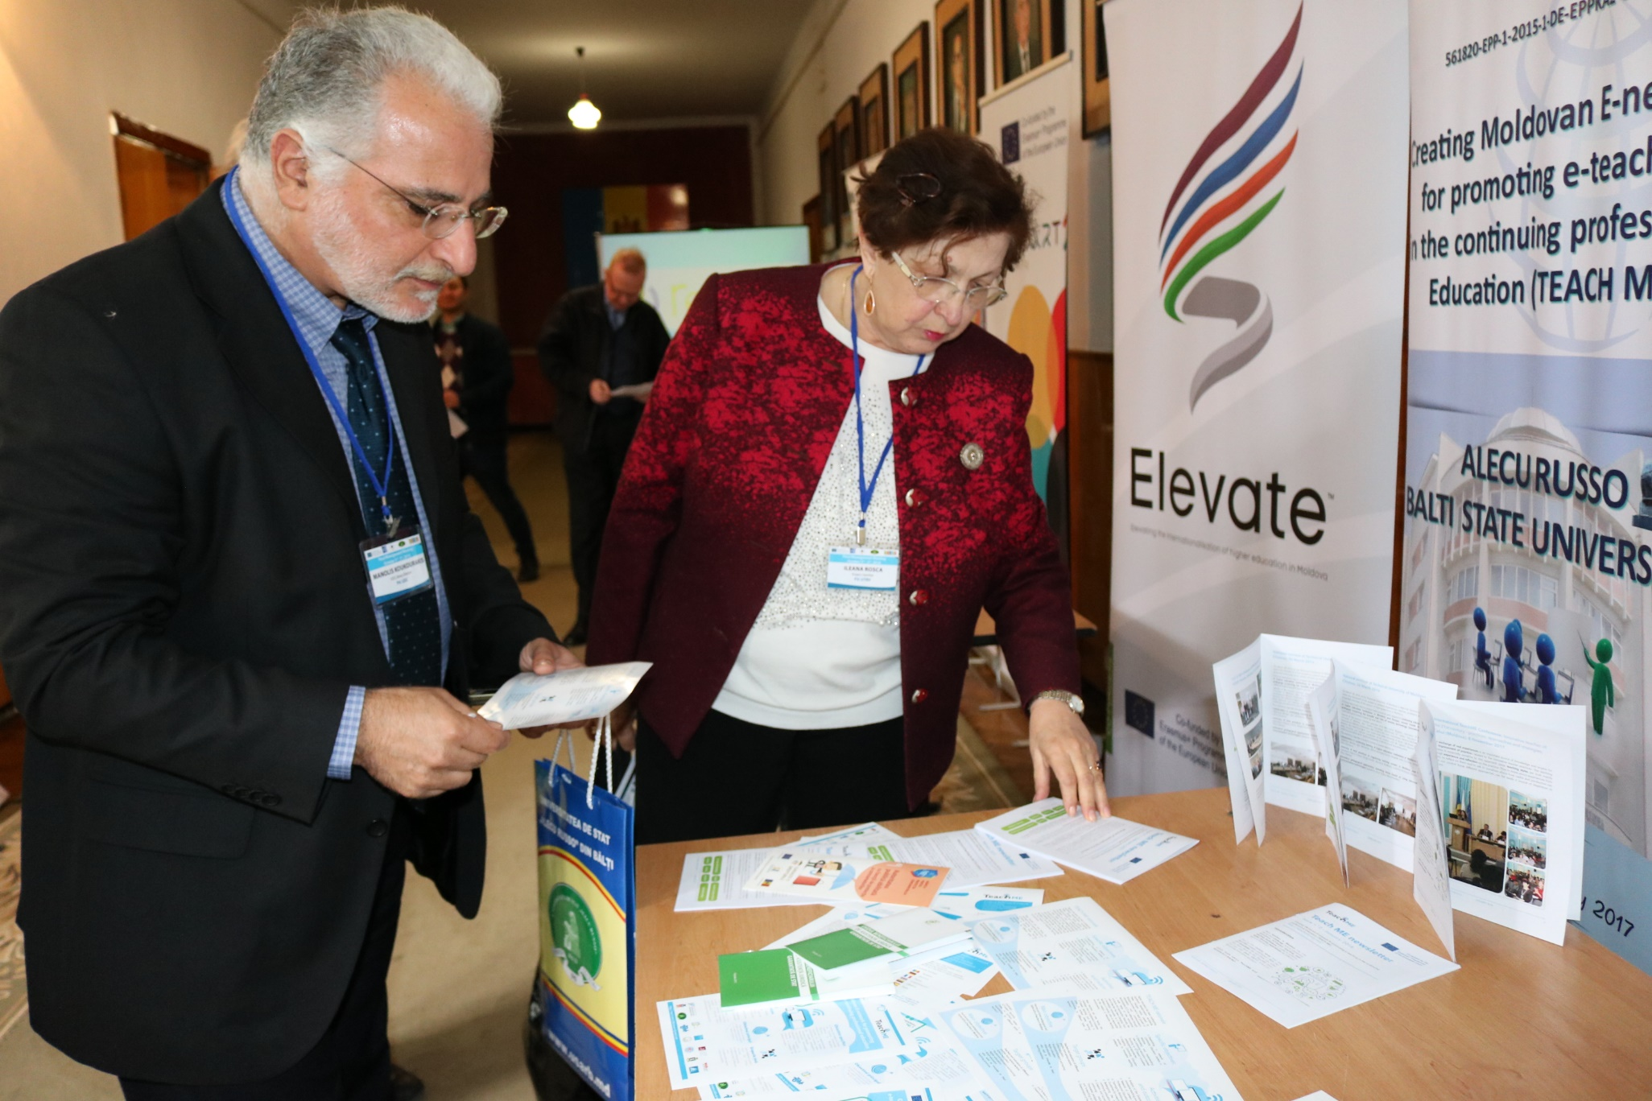
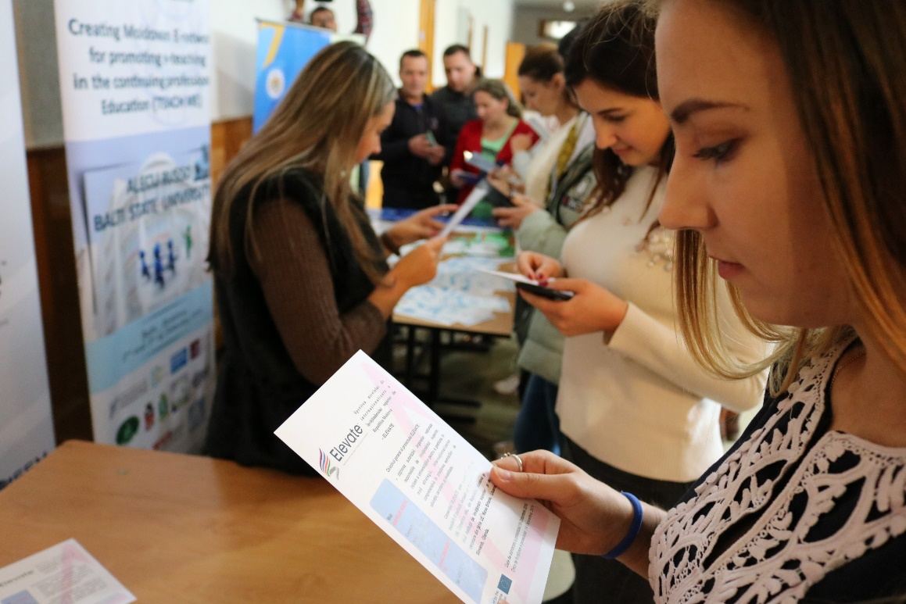
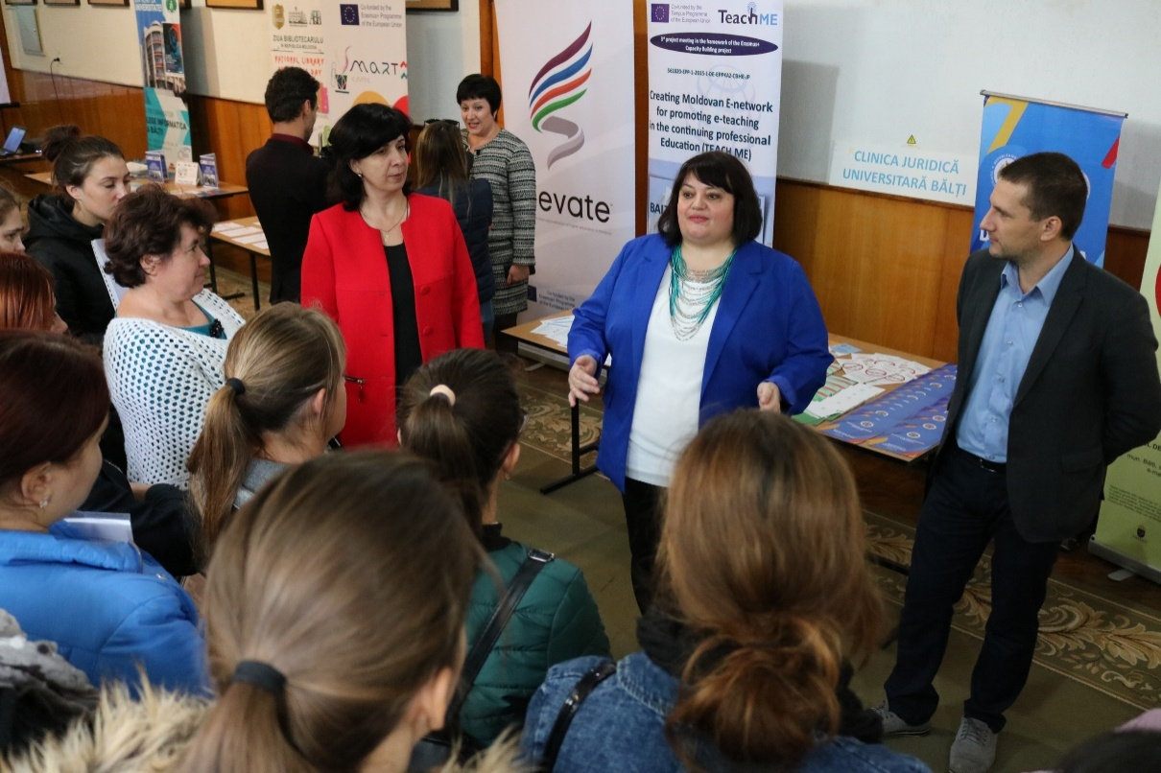
Fair of Erasmus + Projects at USARB
Internationalization at USARB

Slide 22
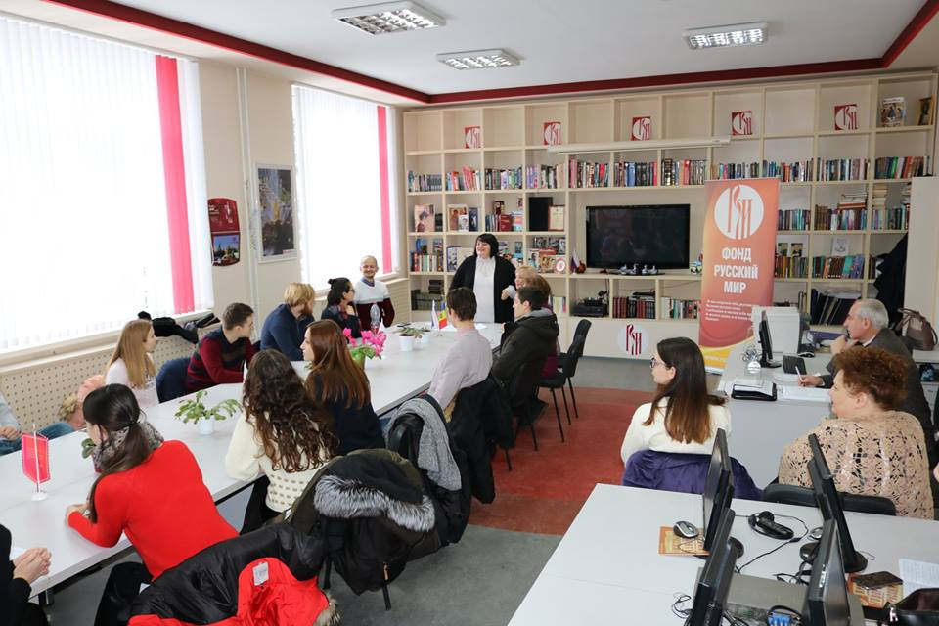
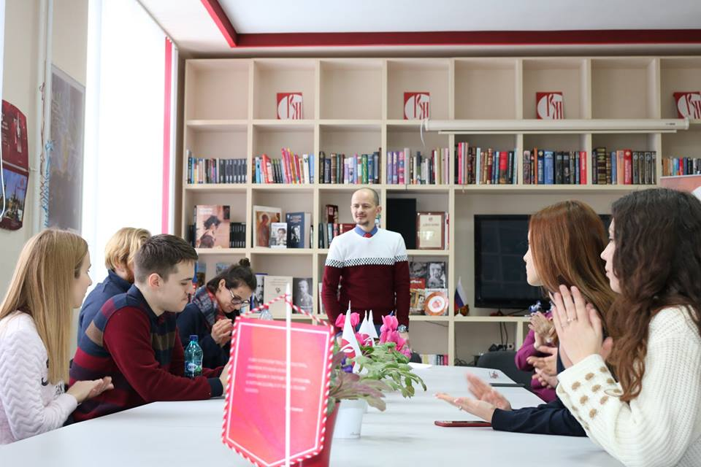
Students of Eötvös Lorand (ELTE) of Budapest at USARB within a WINTER SCHOOL of Russian Language Study
20.01.2019 - 03.02.2019
Internationalization at USARB

Slide 23
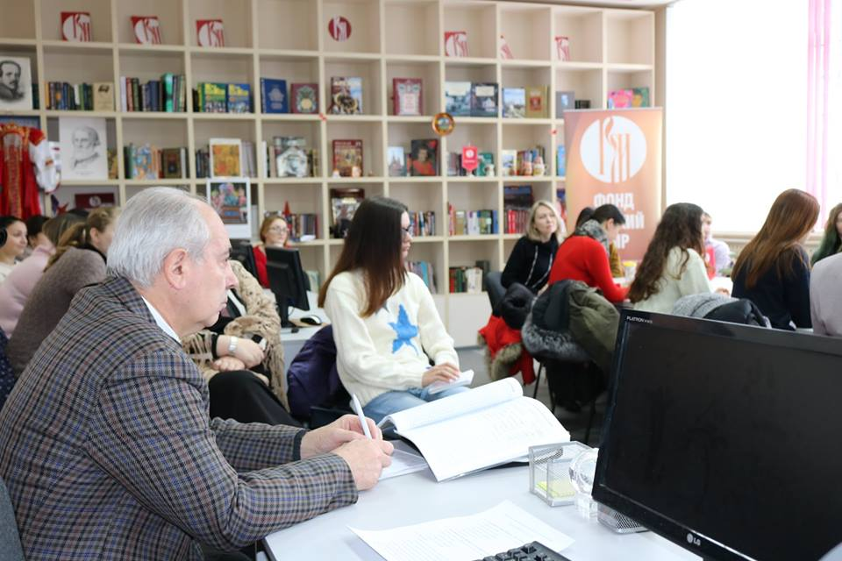
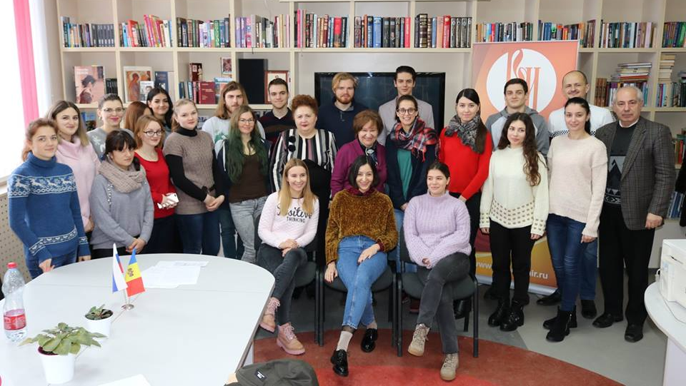
Students of Eötvös Lorand (ELTE) of Budapest at USARB within a WINTER SCHOOL of Russian Language Study
20.01.2019 - 03.02.2019
Internationalization at USARB

Slide 24
Internationalization at USARB
The Japanese Film Festival at USARB

Slide 25
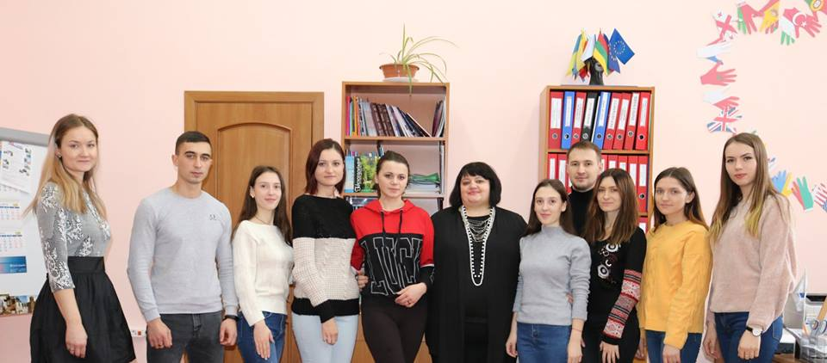
Best Practices at USARB
Internationalization at USARB
Excellent Organization of a 5-month BA incoming mobility (student Carmen Moreno – Univ. of Granada, Spain)
Native Language Speaking Professors within USARB (English, Hungarian, Polish, German)
Promoting International Cultural Values in partnership with Embassies (Joint Cultural Events, Film Days – Poland, Japan)
Excellent Dissemination of Projects (Project Fair, etc)
Good Media Coverage
Close Student Involvement in different International activities
Organization of Translation Internship within the Department of international Relations

Slide 26
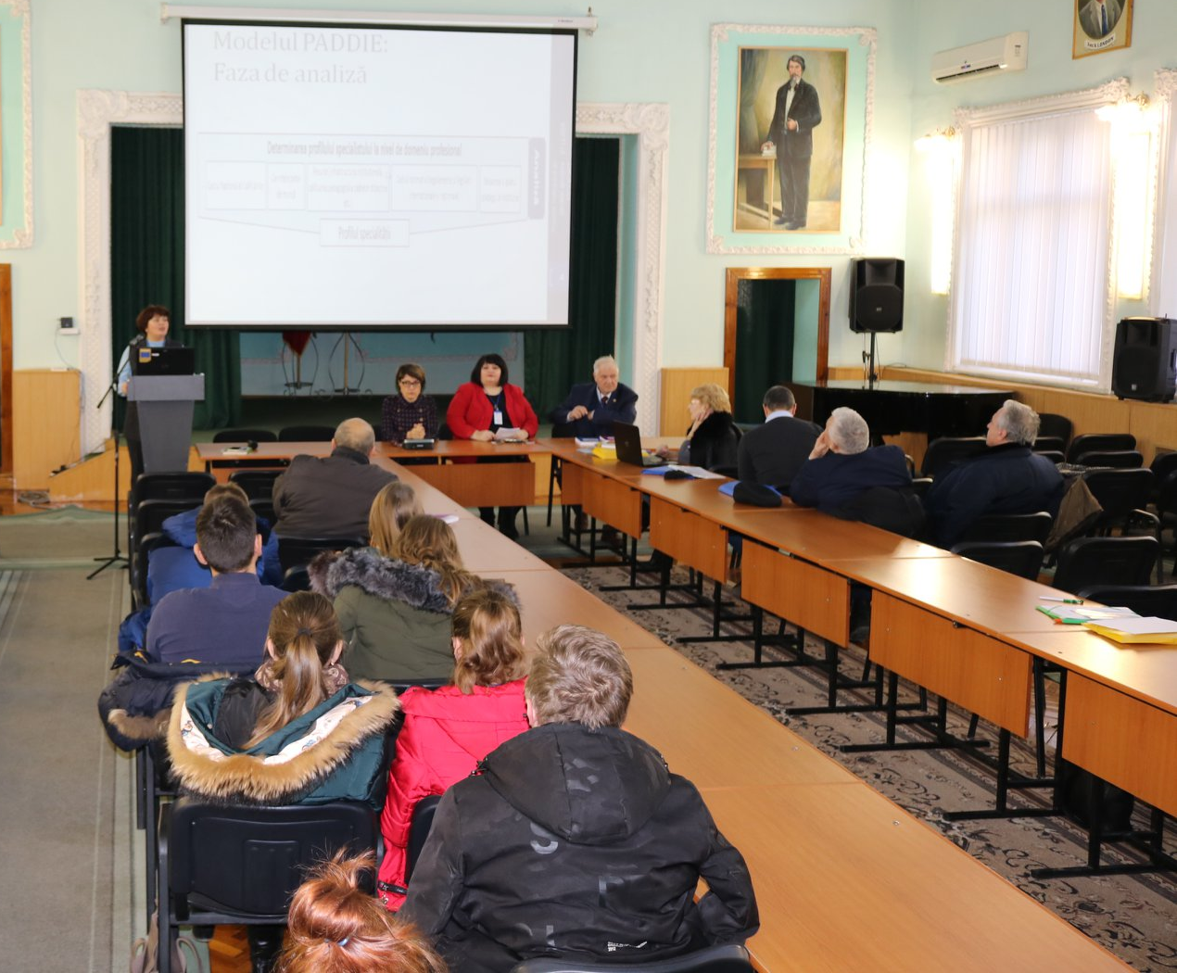
Improved Infrastructure and International Services at USARB
Internationalization at USARB
International Centers
Use of Modern Educational Online Tools and Platforms (Moodle)
Organizing Erasmus Welcome Days / Information Seminars
Collecting and Forming the Erasmus Alumni Database
Updated information on USARB webpage and Facebook page
Better Services for the incoming students (process of arrival, immigration, accommodation, study program, academic progress , extra-curricular activities, guiding procedures, academic consultations with professors and lecturers regarding the study program adjustments , mentoring), etc.

Slide 27
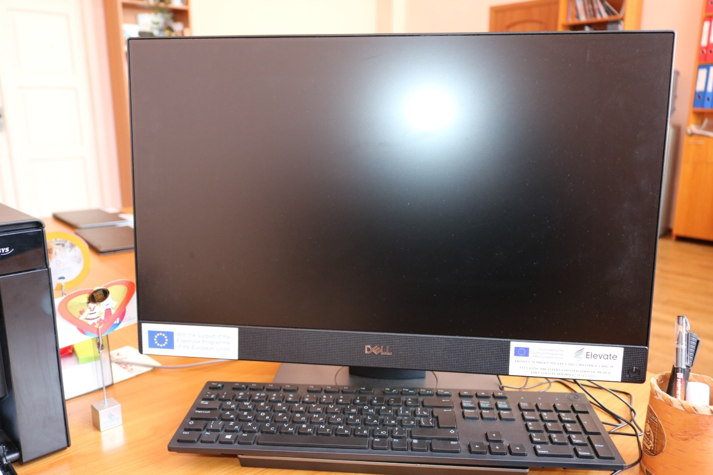
Equipment at USARB

Slide 28
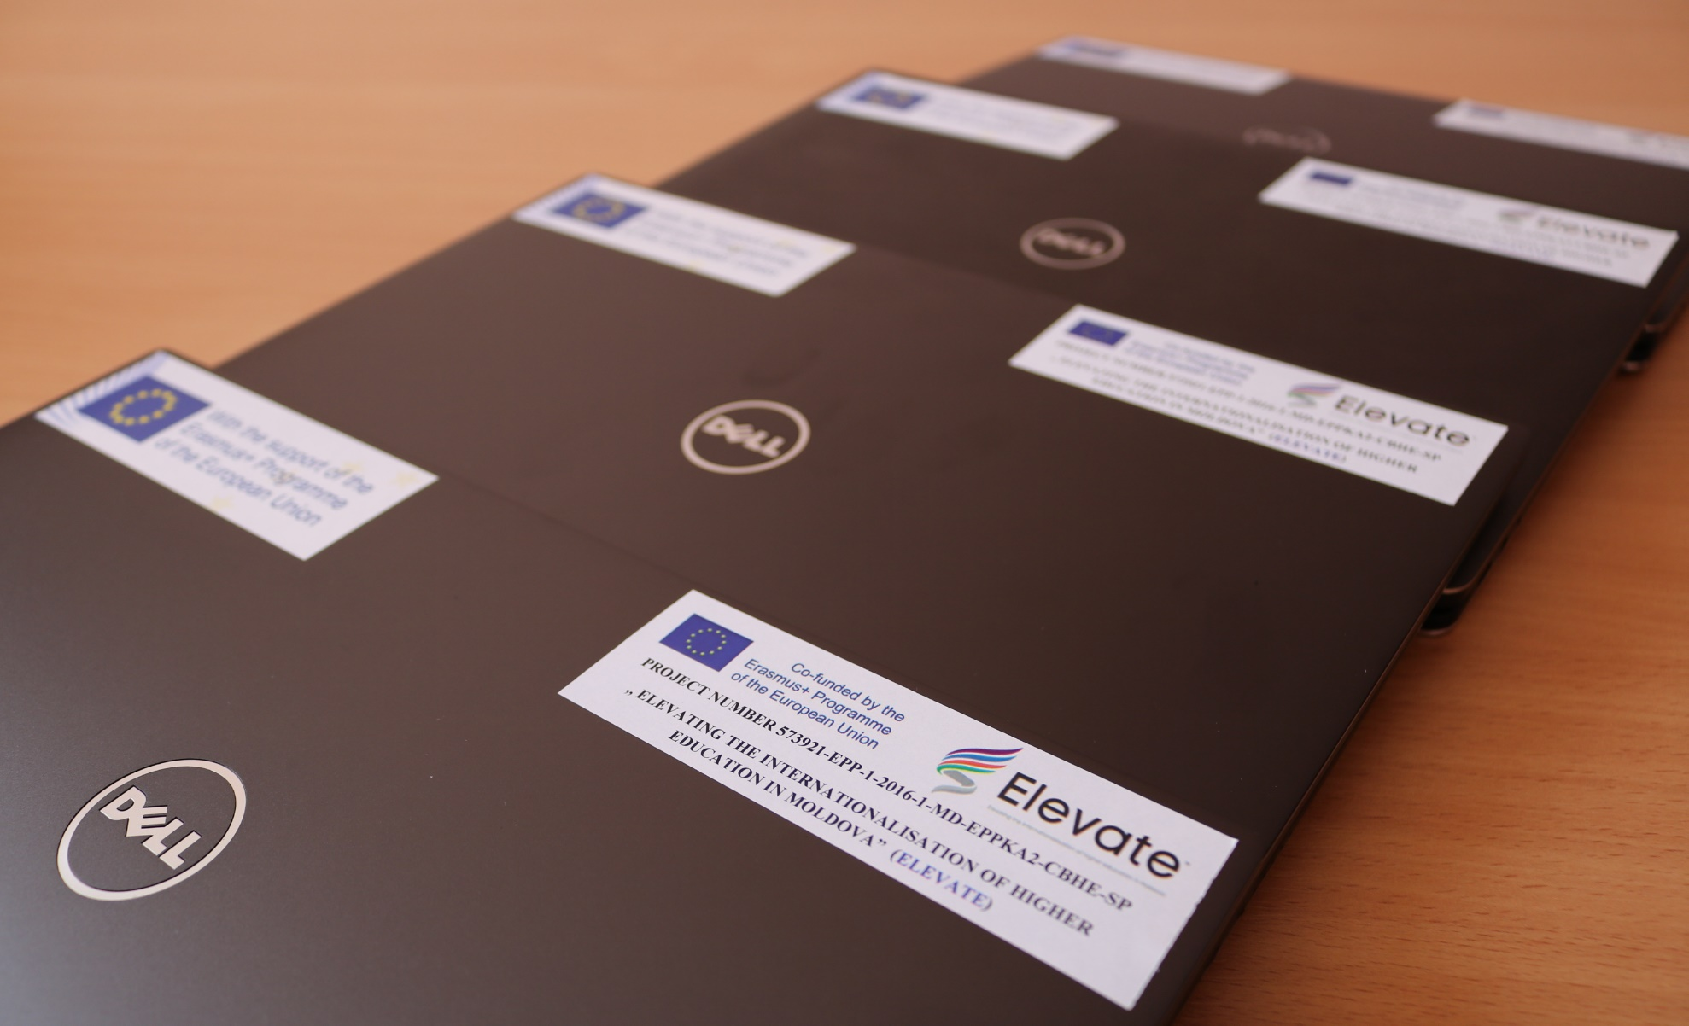
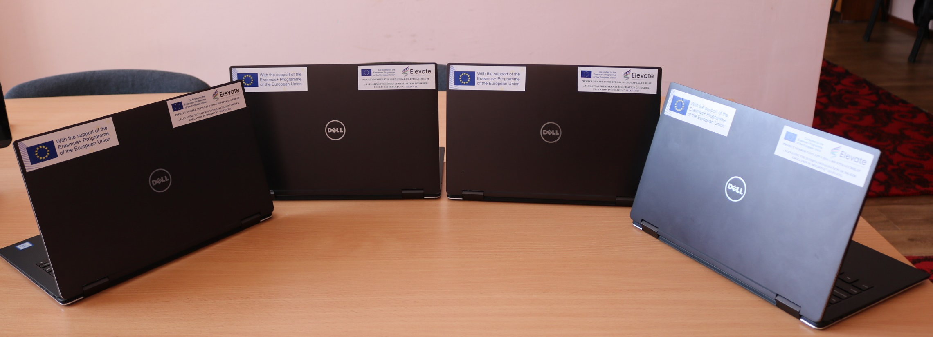
Equipment at USARB

Slide 29
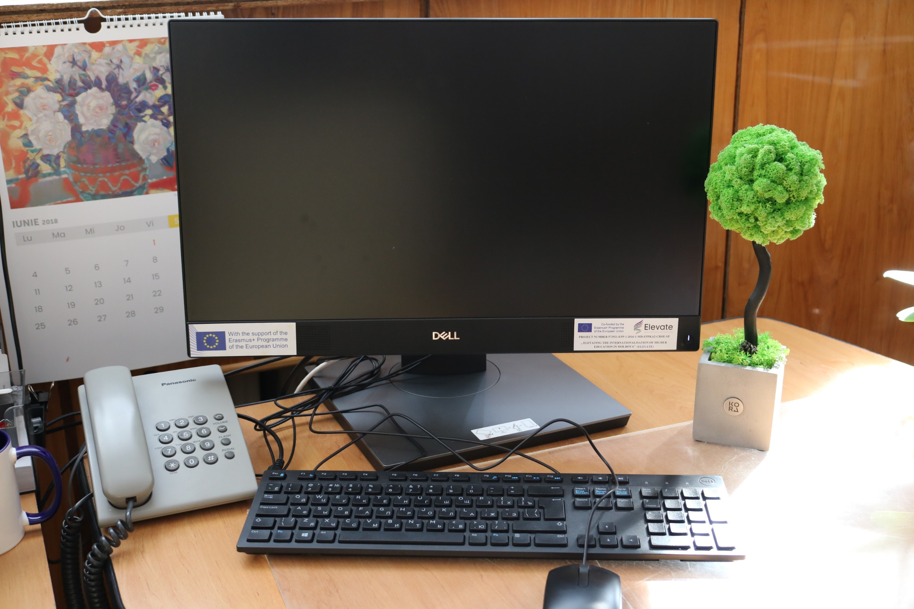
Equipment at USARB

Slide 30
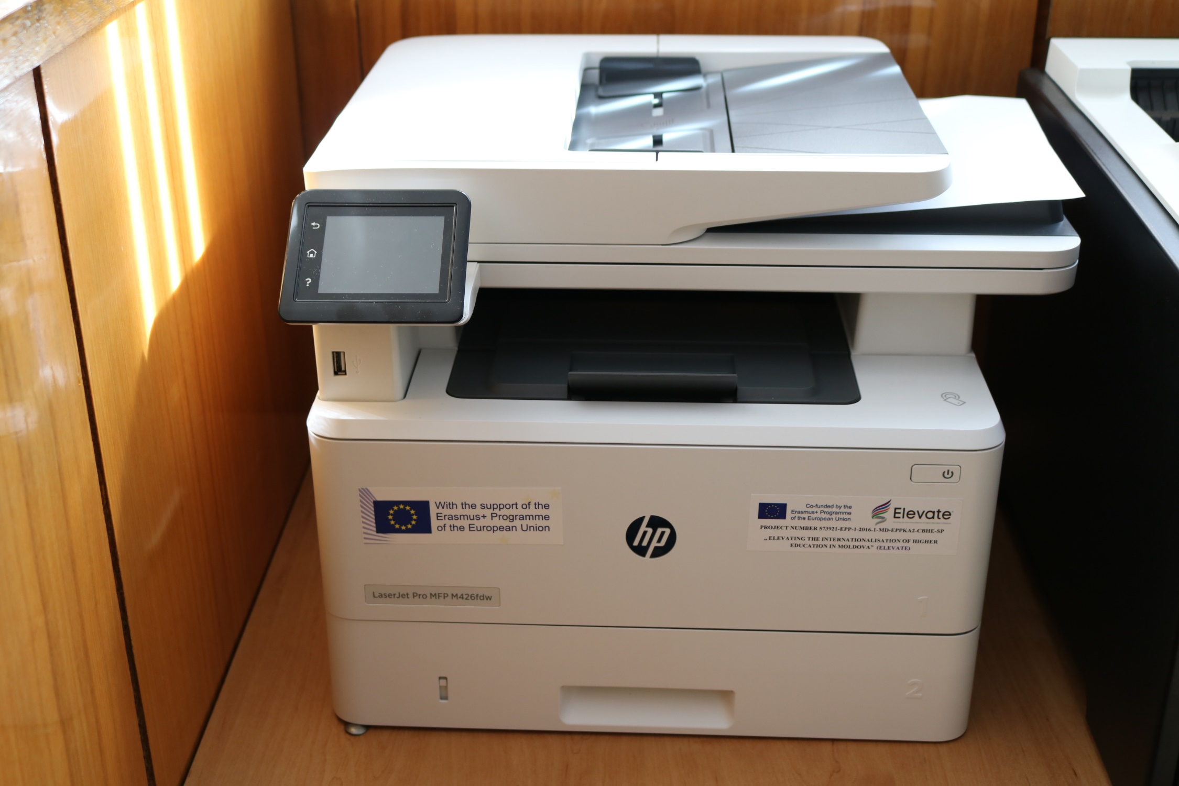
Equipment at USARB

Slide 31
Equipment at USARB
Thank you for your attention !

